Slide 1
Parent Information Meeting for Year 3
Welcome to our Parent Information Meeting!
Aim
To provide information about what is happening in your child’s year group e.g. the curriculum and enrichment opportunities.
To communicate clearly our expectations about behaviour, uniform, attendance, Pupil Review Meetings, homework and positive relationships.

Slide 2
Catholic Ethos
Everything we do is underpinned by our Catholic ethos
As a Catholic School, we seek to live out the values of Jesus Christ. We promote these values by our words and deeds recognising that every child is unique and is created in the image of God.
Jesus told us to "Love one another as I have loved you" and this reminds us every day to go the extra mile for the children within our care.
Our Lady of the Wayside is a school we are all proud of. Our school is a vibrant, positive place that provides a safe and welcoming environment in which to learn.

Slide 3
Home-School Partnership
There is an established link between the home learning environment at all ages and children’s performance at school.
Schools and parents have a shared priority to deliver the best outcomes for their children. You are their first educators - please read daily, support homework and practice times tables with your child.
Please talk to us about what support you would find helpful!

Slide 4
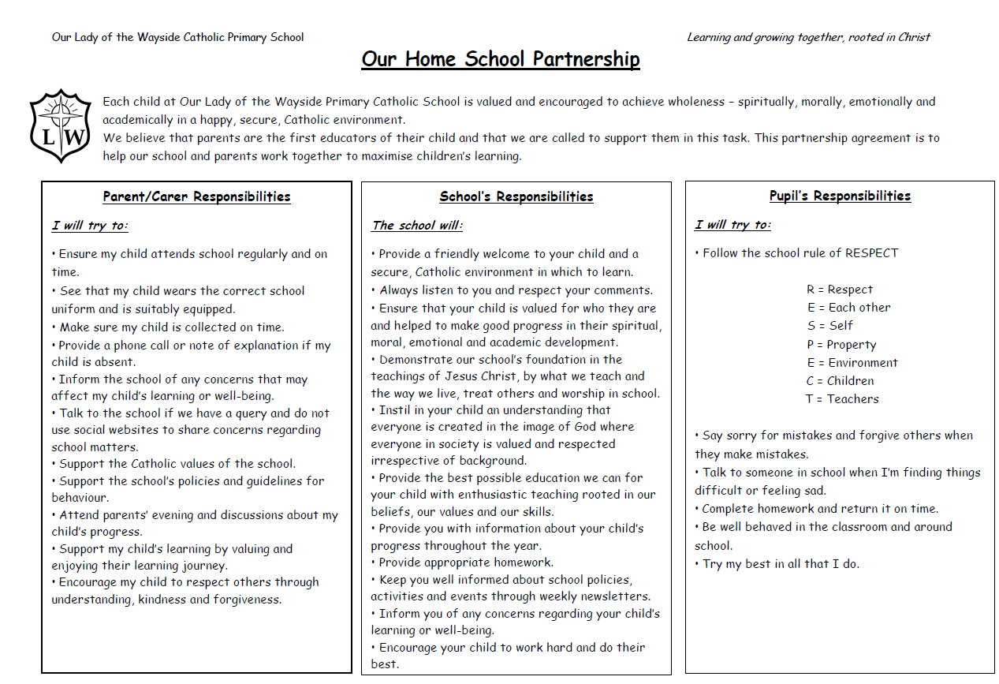
Home-School Partnership

Slide 5
Communication
ParentPay
Marvellous Me
- Reminders
If your child is in the Golden Book
Demonstrated a positive learning behaviour
Ask you to ask your child about their learning twice a week
Instagram
We have a new home-school communication policy which has been emailed to you.

Slide 6
Attendance
Good attendance will ensure that your child will have the best chance to achieve their academic potential and have real opportunity in further education and the world of work.
Did you know that…
95% 9 days 2 weeks 50 lessons missed
90% 19 days 4 weeks 100 lessons missed
85% 29 days 6 weeks 150 lessons missed
It may be tempting to book a family holiday in term time to save on costs. However, this has a major impact on learning.

Slide 7
Punctuality
This year, we are having a drive to ensure that all children are in school punctually and ready to learn. Regular lateness to school, even by a few minutes, is disruptive to the class and possibly upsetting for your child.
Children should be in school before 8.55am. Lateness after 9.05am will be recorded as unauthorised.
Children will be practising basic skills and handwriting from 8:30 – 8:55.
Where attendance/punctuality is an issue, our school attendance team, which includes Mrs Lloyd and Mrs Ashcroft, will invite parents/carers into school for short meetings, and to draw up attendance support plans.

Slide 8
Punctuality - breakfast club 8.30-8.40am
Children are more likely to learn effectively when they have had a healthy breakfast. In addition to having an impact on pupils, the classroom, and schools, parents speak about benefits of the breakfast club, such as having less stress in the morning and fewer arguments with their children over breakfast.
Breakfast club now operates on an opt-out basis.

Slide 9
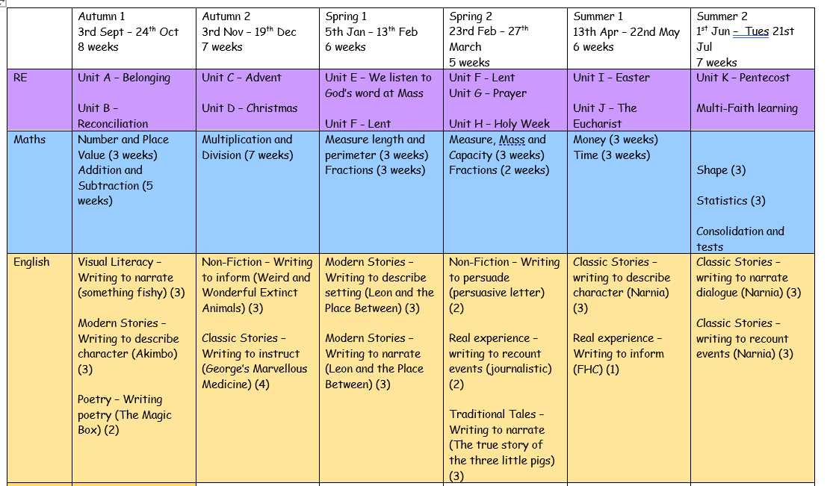
The curriculum for this year

Slide 10
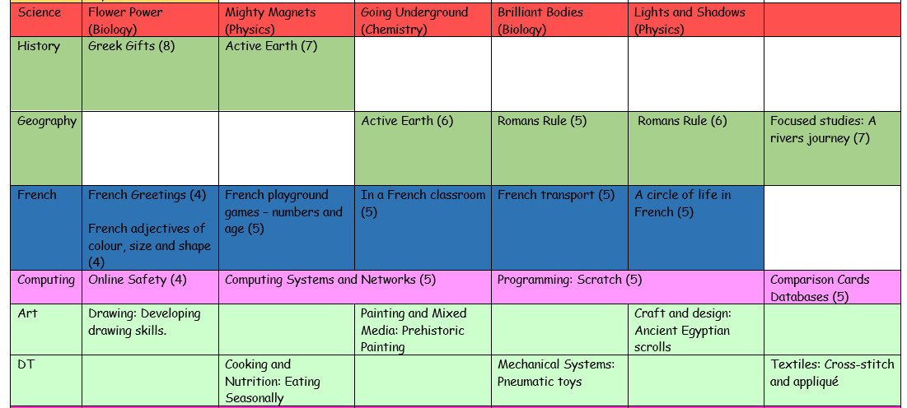

Slide 11
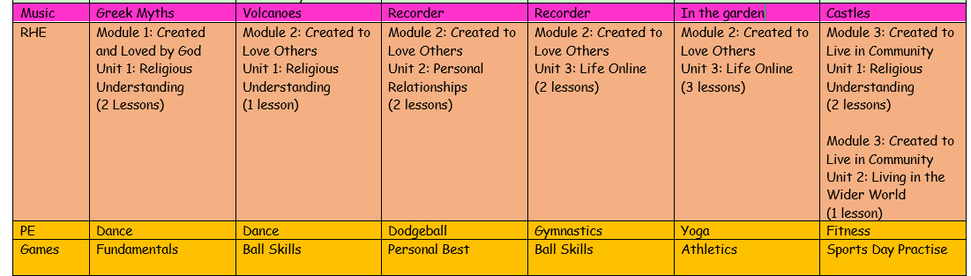

Slide 12
Presentation of Work
This year at Our Lady of the Wayside, we are on a journey to improve handwriting.
Handwriting is more than just a form of communication; it's a fundamental skill that offers a wide range of benefits for your child's cognitive development. Here are some of the key advantages:
Enhanced Reading and Spelling Skills
Improved Memory and Recall
Increased Motivation to Write
Efficiency in Academic Tasks

Slide 13
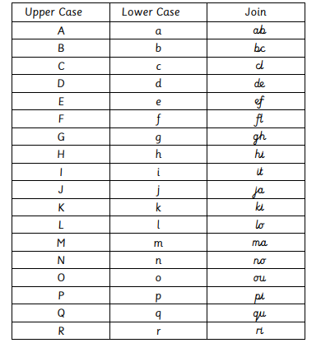
Presentation of Work

Slide 14
Homework
Children who regularly complete homework have better school outcomes than children who do not. Homework has a number of potential benefits including consolidation of what has been learned in lessons, preparation for subsequent lessons and tests and the development of independent learning skills.

Slide 15
Homework
We now have a new Homework Policy which provides clear guidelines about the purpose, expectations and type of homework your child will receive. We firmly believe that the revised homework policy will contribute positively to your child's educational journey. Please take time to read through the policy which you can find on the school website. We ask that you encourage your child to complete homework tasks and to contact teachers (or encourage your children to) if your child needs extra support with homework or if the homework is late/incomplete.

Slide 16
Homework
This year’s homework will involve:
An online book, with a reading record that needs to be signed by the parent’s weekly.
A Maths consolidation task linked to this week’s learning.
An English consolidation task linked to this week’s learning.
Ongoing learning of times tables - worksheets will be provided every week. The children need to know their 2,3,4,5,8 and 10 times tables by the end of Year 3. They will also continue with the online Times tables Rockstars.
Once per term there will be a creative project for children to complete.

Slide 17
Shared reading tips
Tip 1: Ask questions about the book
Asking a range of questions about the book you are reading together. The ‘five Ws’—: who, what, where, when, and why can provide useful questions.
Use a mixture of closed questions (which can be answered with a single word) and open questions (which require a fuller response).
Asked them to summarise what has happened in the book or story so far and to predict what will happen next.
Tip 2: Link reading to the real world
By talking about links between the book and real life, parents can make the story more interesting and help children develop their understanding of ideas in the book. For example, while reading about Cinderella going the ball, a parent might discuss the similarities between a ball and a birthday party.

Slide 18
How parents can help with homework
Parents can help by encouraging a regular routine, and good study habits
Parents can help by knowing about homework, showing interest and encouragement

Slide 19
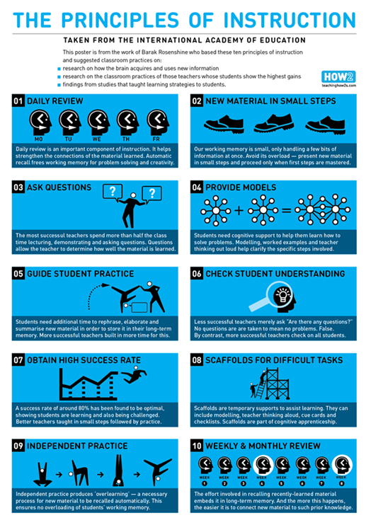
How your children will be learning!
Do now - retrieve something they have learnt
I do - teach them something new
We do - guided practice
You do - independent practice
Please take a handout about Rosenshine’s principles and how we will be using them in class!

Slide 20
Behaviour
We have high expectations of behaviour. This is set out in our behaviour policy. It can be found on our school website.
Good behaviour is rewarded with:
Whole school House Point reward system (Saint Houses)
Golden Book entry and assembly
Golden break time
Marvellous me message or a phone call home
Visit to another teacher/HT/DHT/AHT for commendation
This year we are really promoting positive learning behaviours and will also celebrate your child’s demonstration of these behaviours during Pupil Review Meetings.

Slide 21
Behaviour
Responding to inappropriate behaviour
Staff will respond to inappropriate behaviour predictably, promptly and in a consistent, fair and proportionate manner so that pupils know with certainty that inappropriate behaviour will always be addressed.
At OLW, we have a ‘stepped approach’ for addressing low level behaviours:

Slide 22
Step 1 - Reminder
A child is told that their behaviour is inappropriate (label behaviour) and the impact that it is having on others. They will be offered a chance to change their behaviour and make a good choice.
Step 2 - Verbal Warning
The child is reminded that their behaviour (label behaviour) is still inappropriate and how it is impacting on others. They will be given another chance to change their behaviour and make a good choice.
Step 3 - Calm Time
The child is given some time out in a buddy class, pod room or at the side of the playground. It is a few minutes for the pupil to calm down and reflect on their behaviour.
Step 4 - Repair
A discussion using restorative language takes place at break time with the child.
1. What happened?
2. How were you feeling at the time?
3. How has it affected others?
4. What could you do next time?
5. How can this be repaired?
The repair may involve an appropriate sanction. This will be communicated to parents by the class teacher.

Slide 23
Uniform
Please ensure that your child wears the correct school and PE uniform and that all uniform is labelled clearly:
Light blue short-sleeve/long sleeve shirt with collar and school badge
School tie (all year)
Blue V neck jumper/blue cardigan with gold stripe on the collar
Dark grey school trousers or dark grey school shorts
Dark grey skirt
Dark grey socks
Black shoes (no trainers)
If children have had their ears pierced, they may wear a simple gold/silver stud earing. No diamond or character earrings please.
Hair accessories - simple and plain blue.
Small rucksack style bag - this must fit in school lockers.
SUMMER - Light blue gingham dress/white socks
No nail polish please.

Slide 24
Water bottles
These should contain water, not juice.
Please can we ask that children use smaller water bottles as these fit the water towers.
Please can we also remind you to send your child with a water bottle - we can provide a plastic cup but please try and remember a bottle!

Slide 25
Sharing and Resolving Concerns
A reminder that we have clear pathways to ensure a concern you may have is quickly and effectively resolved. The pathway is:
Stage 1:
Discuss your concern with your child’s class teacher. They will work with you to discuss and resolve your concern. Please allow sufficient time for this process to be completed.
Stage 2:
Please escalate your concern to your child’s Phase Leader who will consider your concern and review the response given by your child’s class teacher. The Phase Leader for academic year 2025-2026 is:
Middle Phase (Year 3 and Year 4) Miss Yarnold

Slide 26
Sharing and Resolving Concerns
Stage 3:
Please escalate your concern to Mrs Ashcroft (Deputy Headteacher) if your child is in Early and Lower Phase and Mrs Ashcroft, Deputy Headteacher if your child is in Middle and Upper Phase. Mrs Ashcroft will consider your concern and review the responses given by your child’s class teacher and your child’s Phase Leader. Please complete a parent escalation form at this stage available from the class teacher.
Stage 4:
Make a formal complaint following the School’s Complaint Policy (available on our website). Mrs Enstone will consider your complaint and review the responses given by Mrs Ashcroft, your child’s Phase Leader and their class teacher.
Please trust us, we will follow procedures but please be respectful of decisions or outcomes.

Slide 27
SEND
Mrs Churchill is our SENCO.
Please do make an appointment with her and your child’s class teacher if you feel your child has an underlying need or if you are concerned about behaviours at home.

Slide 28
Safeguarding
At Our Lady of the Wayside we recognise our moral and statutory responsibility to safeguard and promote the welfare of all pupils. We endeavour to provide a safe and welcoming environment where children are respected and valued. We are alert to the signs of abuse and neglect and follow our procedures to ensure that children receive effective support, protection and justice. Safeguarding our children is the responsibility of every member of staff at OLW.
Our Lady of the Wayside has policies in place for Safeguarding, Child Protection and Behaviour which are read and adhered to by all staff. Visitors, supply teachers etc. must familiarise themselves with the school’s requirements regarding child protection, safeguarding and behavioural expectations.

Slide 29
Safeguarding
We have a dedicated safeguarding team who work together to ensure the safety of all children at OLW.
The school has four named DSL’s (Designated Safeguarding Leads) for Child Protection:
Mrs Enstone (Headteacher)
Mrs Ashcroft (Deputy Headteacher)
Mrs Compton (Y1 Teacher)
Mrs Lloyd (Family Support Manager).
If your child sustains an injury such as a bruise, please inform us about how this has happened as we will be required to investigate as part of our safeguarding procedures.

Slide 30
Children’s social media and online safety
Parents should be mindful when creating social media accounts for their children using an incorrect date of birth. For example, if a parent registers an 8-year-old as 13 in order to access a platform like Snapchat, by the time the child actually turns 13, the app will assume they are 18. This can expose the child to content, features, and interactions intended only for adults, including inappropriate or harmful material.
Accurate age settings are critical to ensure children are protected online and only access content that is age-appropriate.
Why Age Matters on Social Media
Social media platforms set minimum age requirements (often 13+) to protect children.
When parents enter a false age to create an account, it may seem harmless, but it can have serious long-term consequences.

Slide 31
Children’s social media and online safety
Safer Alternatives
✅ Wait until your child is the appropriate age before opening accounts.
✅ Use child-friendly apps and platforms designed for younger users.
✅ Set up parental controls and privacy settings on devices.
✅ Talk openly with your child about online safety, peer pressure, and boundaries.
✅ Regularly check in on their digital activity in a supportive way.
Key Takeaway
Always use your child’s real age when creating accounts. It helps platforms provide the right level of protection and ensures children only access content that is safe and appropriate.
This information will be emailed to you!

Slide 32
Sacramental Preparation
There will be separate parent meetings about sacramental preparation.
Please may all parents attend the First Holy Communion meeting on 29th September at 3.30pm.
It will take place in the school hall and gives you all the relevant information regarding your child’s sacramental preparation.

Slide 33
Pupil Premium
If your child is eligible for ‘free school meals’ and you register them for this, we’ll receive extra funding called ‘pupil premium’. We use this extra money to improve the educational provision and resources at the school.
If you want to find out if your child is eligible for this and how to apply, please see Mrs Chambers in the school office.

Slide 34
Notices and questions
If your child has any reading/school library books at home, please bring them in as soon as possible.
Please remember to pre-order your child’s lunch online.
Any questions, please ask!
Thank you for attending the Parent Information Meeting for Y3.

