Slide 1
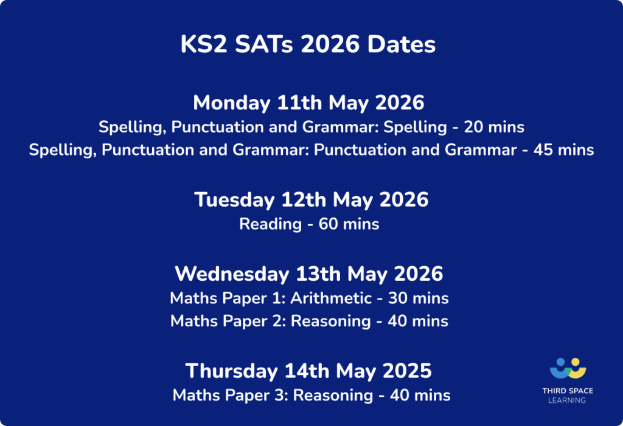
Dates for your diary
Confirmation
TBC
20th September 5:30pm
Year 6 Commitment Mass
15/16th October
Parents’ Evening
5th December 2.45pm
Year 6 Advent Service
Residential to Dol- Y- Moch
Monday 1st – Thursday 4th June 2026

Slide 2
Parent Information Meeting for Y6
Welcome to our Parent Information Meeting
Aim
To provide information about what is happening in your child’s year group e.g. the curriculum and enrichment opportunities.
To communicate clearly our expectations about behaviour, uniform, attendance, Pupil Review Meetings, homework and positive relationships.

Slide 3
Catholic Ethos
Everything we do is underpinned by our Catholic ethos
As a Catholic School, we seek to live out the values of Jesus Christ. We promote these values by our words and deeds recognising that every child is unique and is created in the image of God.
Jesus told us to "Love one another as I have loved you" and this reminds us every day to go the extra mile for the children within our care.
Our Lady of the Wayside is a school we are all proud of. Our school is a vibrant, positive place that provides a safe and welcoming environment in which to learn.

Slide 4
Attendance
Good attendance will ensure that your child will have the best chance to achieve their academic potential and have real opportunity in further education and the world of work.
Did you know that…
95% 9 days 2 weeks 50 lessons missed
90% 19 days 4 weeks 100 lessons missed
85% 29 days 6 weeks 150 lessons missed
It may be tempting to book a family holiday in term time to save on costs. However, this has a major impact on learning.

Slide 5
Punctuality
This year, we are having a drive ensure that all children are in school punctually and ready to learn. Regular lateness to school, even by a few minutes, is disruptive to the class and possibly upsetting for your child.
Children should be in school before 8.55am. Lateness after 9.05am will be recorded as unauthorised.
Where attendance/punctuality is an issue our school attendance team which includes Mrs Lloyd and Mrs Ashcroft, will invite parents/carers into school for short meetings, and to draw up attendance support plans.

Slide 6

One page document on class pages

Slide 7
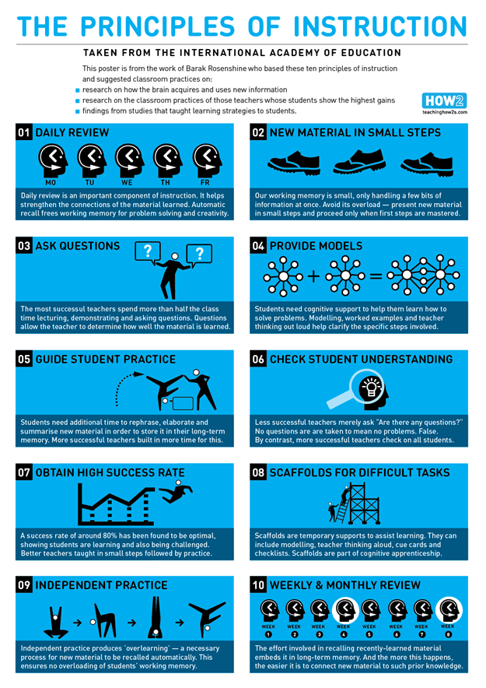

Slide 8
Homework
Our Homework Policy which provides clear guidelines about the purpose, expectations and type of homework your child will receive.
We ask that you encourage your child to complete homework tasks and to contact teachers (or encourage their children to) if their child needs extra support with homework or if the homework is late/incomplete

Slide 9
Homework
Spelling rules taught in class and follow up work given out on a Friday.
Maths homework (usually MyMaths) set on a Friday.
Read independently or be heard read for 15 minutes per night
Weekly homework is due the following Friday.

Slide 10


Slide 11
Behaviour
We have high expectations of behaviour. This is set out in our behaviour policy. It can be found on our school website.
Good behaviour is rewarded with:
Whole school House Point reward system (Saint Houses)
Golden Book entry
Golden Book assembly
Golden break time
Marvellous Me message sent home
Stickers/stamps
Personalised reward chart
Visit to another teacher/HT/DHT/AHT for commendation
This year we are really promoting positive learning behaviours and will celebrate your child’s demonstration of these behaviours on Marvellous Me and in Pupil Review Meetings.

Slide 12
Behaviour
Responding to inappropriate behaviour
Staff will respond to inappropriate behaviour predictably, promptly and in a consistent, fair and proportionate manner so that pupils know with certainty that inappropriate behaviour will always be addressed.
At OLW, we have a ‘stepped approach’ for addressing low level behaviours.
Step 1 - 1st verbal warning
A child is told that their behaviour is inappropriate (label behaviour) and the impact that it is having on others. They will be offered a chance to change their behaviour and make a good choice.
Step 2 – 2nd verbal warning
The child is reminded that their behaviour (label behaviour) is still inappropriate and how it is impacting on others. They will be given another chance to change their behaviour and make a good choice.
Step 3 – Calm time
The child is told that they have been spoken to twice about their inappropriate behaviour (label behaviour) and that they will have some time out in the classroom to help them change and reflect on their behaviour.

Slide 13
Behaviour
Step 4 – Repair time
Discuss how to repair the situation. What happened? How were you feeling? How has it affected others etc
Step 5 – Loss of some lunchtime break supervised in class
Children missing part/all of lunchtime break will be supervised in a classroom by the class teacher.
This stepped approach is clearly visible as a Consequence Ladder poster displayed in each classroom. At each stage, staff will try to identify the reasons for a behaviour and help a child to reflect and change their behaviours.

Slide 14
Uniform
Please ensure that your child wears the correct school uniform and PE uniform
That uniform is labelled
No jewellery please
PE – hair tied up.
Water bottles- water only please

Slide 15
Communication
Parentpay
Marvellous Me
- Reminders
Demonstrated a positive learning behaviour
Ask you to ask your child about their learning twice a week
Instagram
Please email through the school office, not the teacher directly.

Slide 16
Sharing and Resolving Concerns
A reminder that we have clear pathways to ensure a concern you may have is quickly and effectively resolved. The pathway is:
Stage 1:
Discuss your concern with your child’s class teacher. They will work with you to discuss and resolve your concern. Please allow sufficient time for this process to be completed.
Stage 2:
Please escalate your concern to your child’s Phase Leader who will consider your concern and review the response given by your child’s class teacher. The Phase Leaders for academic year 2024-2025 are:
Early Phase (Nursery and Reception) Mrs Churchill
Lower Phase (Year 1 and Year 2) Mrs Compton
Middle Phase (Year 3 and Year 4) Miss Yarnold
Upper Phase (Year 5 and Year 6) Miss McNamee

Slide 17
Sharing and Resolving Concerns
Stage 3:
Please escalate your concern to Mrs Ashcroft, Deputy Headteacher. Mrs Ashcroft will consider your concern and review the responses given by your child’s class teacher and your child’s Phase Leader. Please complete a parent escalation form at this stage available from the class teacher.
Stage 4:
Make a formal complaint following the School’s Complaint Policy (available on our website). Mrs Enstone will consider your complaint and review the responses given by Mrs Ashcroft, your child’s Phase Leader and their class teacher.
Please trust us, we will follow procedures but please be respectful of decisions or outcomes.

Slide 18
Parents’ Evening
We will continue with the process we introduced last year:
You will be invited to attend a Pupil Review Meeting throughout the year which will be a mixture of face to face and online where your child’s pupil report card will be discussed and targets set and reviewed.
This term – 15th and 16th October
Pupils also attend the meeting so that the child is at the heart of the process

Slide 19
SEND
Mrs Churchill is our SENCo.
Please do make an appointment with her and your child’s class teacher if you feel your child has an underlying need or if you are concerned about behaviours at home.

Slide 20
Safeguarding
At Our Lady of the Wayside we recognise our moral and statutory responsibility to safeguard and promote the welfare of all pupils. We endeavour to provide a safe and welcoming environment where children are respected and valued. We are alert to the signs of abuse and neglect and follow our procedures to ensure that children receive effective support, protection and justice. Safeguarding our children is the responsibility of every member of staff at OLW.
Our Lady of the Wayside has policies in place for Safeguarding, Child Protection & Behaviour which are read and adhered to by all staff. Visitors, supply teachers etc. must familiarise themselves with the school’s requirements regarding child protection, safeguarding and behavioural expectations.

Slide 21
Safeguarding
We have a dedicated safeguarding team who work together to ensure the safety of all children at OLW.
The school has four named DSL’s (Designated Safeguarding Leads) for Child Protection:
Mrs Enstone (Headteacher), Mrs Ashcroft (Deputy Headteacher), Mrs Churchill (Assistant Headteacher), Mrs Compton (Y1 Teacher) and Mrs Lloyd (Family Support Manager).

Slide 22
Enrichment Opportunities
Part of Confirmation preparation we visit St. Chad’s Cathedral
Thursday 26th February 2026
Variety of sports teams and competitions throughout the year: netball, football, basketball, rounders and badminton.

Slide 23
Questions
Thank you for attending the Parent Information Meeting for Y6
Does anyone have any questions?

