Slide 1

Common Prayers to be Known

Slide 2
Prayers to be known by phase
Age Phase | 4-5 (EYFS) | 5-7 (KS1) | 7-9 (Lower KS2) | 9-11 (Upper KS2) | 11 – 14 (KS3)
Prayers | The Sign of the Cross The Lords Prayer Hail Mary | Morning Offering - KS1 Grace before meals – KS1 Grace after meals – KS1 Prayer at the end of the day – KS1 Glory Be | Morning Offering – KS2 Grace before meals - KS2 Grace after meals – KS2 Prayer at the end of the day – KS2 The Apostles’ Creed An Act of Contrition Angel of God The Prayer of St Richard of Chichester Act of Faith Act of Hope Act of Love | The Rosary The Magnificat Come, Holy Spirit | The Benedictus The Angelus Hail Holy Queen The Memorare Jesus, Mary and Joseph, I give you Eternal Rest Diocesan Prayer for Vocations
Notes:
Press ctrl + the link to go to the prayer within the PP

Slide 3
EYFS

Slide 4

Sign of the Cross
In the name of the Father,
and of the Son,
and of the Holy Spirit.
Amen.
Notes:
The sign of the cross is both an action and a statement of faith. A physical reminder of our redemption in the cross and an expression of faith in the Trinity.
This prayer is most often used to enter in to prayer and to demarcate the end of prayer. In both the words and actions we acknowledge God in three persons of the Trinity. Foundation teachers may need to mirror the actions in order to help the children make it correctly.

Slide 5
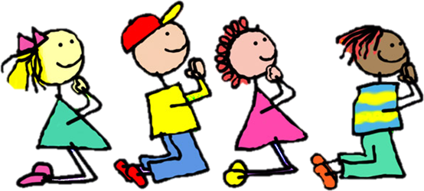
The Lords Prayer
Our Father, who art in heaven,
hallowed be thy name.
Thy kingdom come.
Thy will be done on earth, as it is in heaven.
Give us this day our daily bread,
and forgive us our trespasses,
as we forgive those who trespass against us.
And lead us not into temptation,
but deliver us from evil.
Amen.
Notes:
The Lord’s Prayer ‘is truly the summary of the whole of the Gospel’. (CCC 2761.)
This prayer is also known as the Lord’s prayer as the words were used by Jesus when his disciples asked how they should pray. In this prayer we ask for God’s kingdom to come, not to be put to the test in case we fail and we also ask for forgiveness. This prayer should form part of prayer on a regular and frequent basis. Sung versions can also be used.

Slide 6
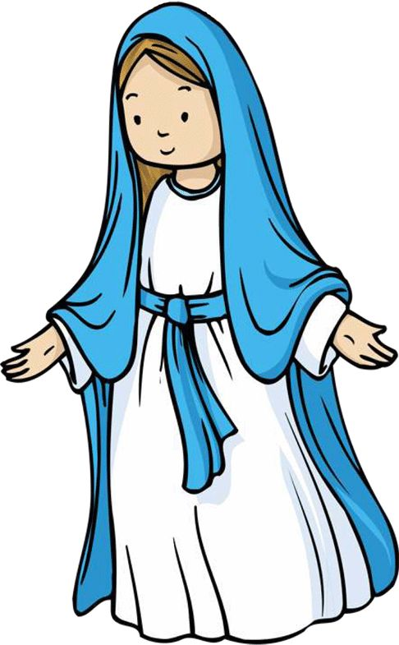
Hail Mary
Hail Mary, full of grace,
the Lord is with thee:
blessed art thou among women,
and blessed is the fruit of thy womb, Jesus.
Holy Mary, Mother of God,
pray for us sinners,
now and at the hour of our death.
Amen.
Notes:
This prayer is based on the words of the angel Gabriel at the Annunciation and Elizabeth, Mary’s cousin at the Visitation. Gabriel greets Mary and shares God’s plan for her. Elizabeth is the first to acknowledge Mary’s role in God’s plan. In this prayer we ask Mary to pray for us/intercede for us both in the present moment and at the moment of our death. This is a prayer that should be used very regularly. Note that it forms the basis of other Marian prayers : The Rosary and the Angelus.
Some of the phrases in this Marian prayer are associated with the Solemnity of the Immaculate Conception. These are ‘full of grace’, ‘the Lord is with you’, ‘Blessed are you among women.’
The phrase ‘Holy Mary Mother of God’ emphasises our belief in Mary’s place in the Church.
Sung versions can also be used.

Slide 7
KS1

Slide 8

Morning Prayer – KS1
Father in heaven, you love me,
you are with me night and day.
I want to love you always
in all I do and say.
I’ll try to please you, Father,
bless me through the day.
Amen.
Notes:
The Church prays at particular times of the day (known as the Liturgy of the Hours) including the start and end of the day. This habit of prayer is reflected in the school day.
At the start of the day we give thanks to God for the gift of life and a new day to share with others and we offer all we do to him. At the end of the day we reflect on how the day has been: the ways in which we have followed God as well as the times we have failed.

Slide 9

Grace Before Meals – KS1
Bless us, O God, as we sit together.
Bless the food we eat today.
Bless the hands that made the food.
Bless us, O God.
Amen.
Notes:
These prayers are said before and after every meal. In them we give praise and thanks to God for providing us with what we need to sustain us. We also give thanks to him for those people who have prepared the meal. These prayers can be said either in the classroom or in the dining room.

Slide 10
Grace after meals – KS1
Thank you, God, for the food we have eaten.
Thank you, God, for all our friends.
Thank you, God, for everything,
Thank you God.
Amen.
Notes:
These prayers are said before and after every meal. In them we give praise and thanks to God for providing us with what we need to sustain us. We also give thanks to him for those people who have prepared the meal. These prayers can be said either in the classroom or in the dining room.

Slide 11


Prayer at the end of the day – KS1
God our Father, I come to say
thank you for your love today.
Thank you for my family
and all the friends you give to me.
Guard me in the dark of night
and in the morning send your light.
Amen.
Notes:
The Church prays at particular times of the day (known as the Liturgy of the Hours) including the start and end of the day. This habit of prayer is reflected in the school day.
At the start of the day we give thanks to God for the gift of life and a new day to share with others and we offer all we do to him. At the end of the day we reflect on how the day has been: the ways in which we have followed God as well as the times we have failed.

Slide 12
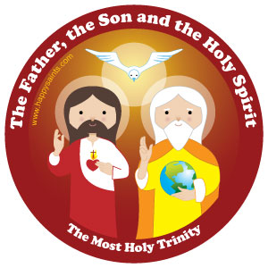
Glory Be
Glory be to the Father,
and to the Son,
and to the Holy Spirit,
as it was in the beginning,
is now, and ever shall be,
world without end.
Amen.
Notes:
Like the Sign of the Cross this prayer acknowledges the Blessed Trinity. It is a prayer of praise acknowledging God’s timeless presence from before the beginning of time and into all eternity. It is also a form of doxology (a short, formulaic prayer giving praise to God) like that used by the priest at the end of the Eucharistic Prayer.

Slide 13
LKS2

Slide 14
Morning Prayer – KS2
O Jesus,
through the most pure heart of Mary,
I offer you all my prayers,
thoughts, works and sufferings of this day
for all the intentions of your most Sacred heart.
Notes:
The Church prays at particular times of the day (known as the Liturgy of the Hours) including the start and end of the day. This habit of prayer is reflected in the school day.
At the start of the day we give thanks to God for the gift of life and a new day to share with others and we offer all we do to him. At the end of the day we reflect on how the day has been: the ways in which we have followed God as well as the times we have failed.

Slide 15
Grace Before Meals – KS2
Bless us, O Lord, and these your gifts
which we are about to receive from your bounty.
Through Christ our Lord.
Amen
Notes:
These prayers are said before and after every meal. In them we give praise and thanks to God for providing us with what we need to sustain us. We also give thanks to him for those people who have prepared the meal. These prayers can be said either in the classroom or in the dining room.

Slide 16
Grace after meals – KS2
We give you thanks, Almighty God,
for all your benefits,
who live and reign, world without end.
Amen
Notes:
These prayers are said before and after every meal. In them we give praise and thanks to God for providing us with what we need to sustain us. We also give thanks to him for those people who have prepared the meal. These prayers can be said either in the classroom or in the dining room.

Slide 17
Prayer at the end of the day – KS2
Lord Jesus Christ,
As we come to the end of this school day,
Help us to reflect and to pray:
For the difficulties I have known, I ask for your help.
For the blessings I have received; I thank you.
May I seek to be an instrument of your peace in my home today.
Each day is a gift.
May I look forward to a new start tomorrow.
May the journey of my life be an experience of your love,
your compassion,
your forgiveness
and your peace
Amen.
Notes:
The Church prays at particular times of the day (known as the Liturgy of the Hours) including the start and end of the day. This habit of prayer is reflected in the school day.
At the start of the day we give thanks to God for the gift of life and a new day to share with others and we offer all we do to him. At the end of the day we reflect on how the day has been: the ways in which we have followed God as well as the times we have failed.

Slide 18
Apostles creed
I believe in God,
the Father almighty
Creator of heaven and earth,
And in Jesus Christ, his only Son, our Lord,
(At the words that follow up to and including the Virgin Mary, all bow)
who was conceived by the Holy Spirit,
Born of the Virgin Mary
Suffered under Pontius Pilate,
was crucified, died and was buried;
Notes:
Based on baptismal documents of the 8th century but related to texts of an earlier origin.
The Creed is a prayer in which we profess our faith. The Apostles Creed is shorter than the Nicene Creed.
The Apostles’ Creed may be used at Mass during Lent and Easter time.

Slide 19
Apostles creed
he descended into hell;
on the third day he rose again from the dead;
he ascended into heaven,
and is seated at the right hand of God the Father almighty;
From there he will come to judge the living and the dead.
Notes:
Based on baptismal documents of the 8th century but related to texts of an earlier origin.

Slide 20
Apostles creed
I believe in the Holy Spirit,
the holy catholic Church,
the communion of saints,
the forgiveness of sins,
the resurrection of the body,
and life everlasting.
Amen
Notes:
Based on baptismal documents of the 8th century but related to texts of an earlier origin.

Slide 21
An Act of Contrition
O my God,
bcause you are so good,
I am very sorry that I have sinned against you,
and with the help of your grace
I will not sin again
Notes:
This sorry prayer can be used at any time. In it we ask God for his forgiveness. This prayer can also be used as an act of contrition during the Sacrament of Reconciliation (usually made for the first time in Y3).

Slide 22

Prayer to the Guardian Angel
Angel of God, my guardian dear,
to whom God's love commits me here,
ever this day be at my side,
to light and guard, to rule and guide.
Amen.
Notes:
The prayer is based on one by Reginald of Canterbury in the early 12th century.
It is part of our belief that part of the role of angels is to watch over us. The feast of the Guardian Angels is on October 2

Slide 23
Prayer of St. Richard of Chichester
Day by day,
O dear Lord,
three things I pray:
to see you more clearly,
love you more dearly,
follow you more nearly,
day by day,
by day, by day.
Amen.
Notes:
This prayer helps to remind us that our relationship with God develops over time. In it we are asking that bit by bit we will come to deepen our need, love and understanding of God and thus our faith in him is strengthened.

Slide 24
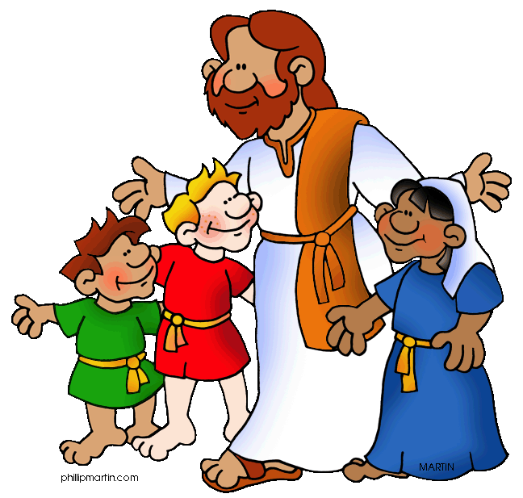
Act of Faith, Hope and Love
Jesus, I believe in you.
Jesus, I hope in you.
Jesus, I love you.
Notes:
This prayer is an expression of the virtues of Faith, Hope and Love which are gifts received through the Holy Spirit at the Sacrament of Baptism. In this prayer our belief, hope and love for Jesus is expressed.

Slide 25


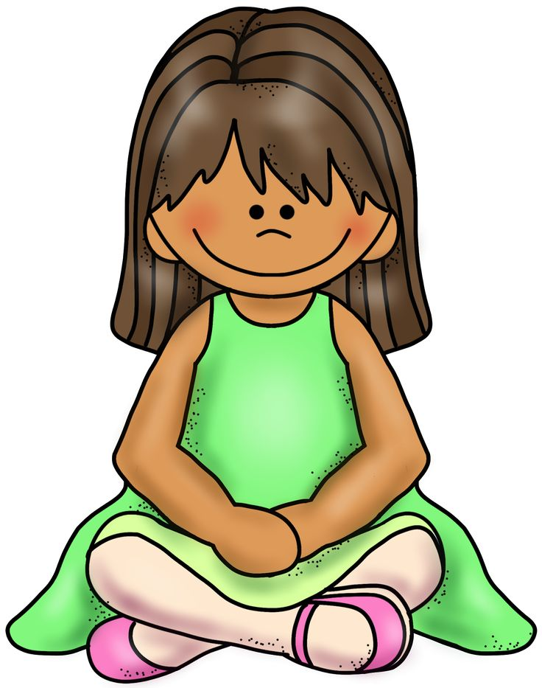
Act of Faith
My God, I believe in you
and all your Church teaches,
because you have said it
and your word is true.
Notes:
These prayers are an expression of the virtues of Faith, Hope and Love which are gifts received through the Holy Spirit at the Sacrament of Baptism. In these prayers our belief, hope and love for God is expressed and is accompanied by a recognition of awe and wonder for God.

Slide 26

Act of Hope
My God, I hope in you,
for grace and for glory,
because of your promises,
your mercy and power.
Notes:
These prayers are an expression of the virtues of Faith, Hope and Love which are gifts received through the Holy Spirit at the Sacrament of Baptism. In these prayers our belief, hope and love for God is expressed and is accompanied by a recognition of awe and wonder for God.

Slide 27

Act of Love
My God, because you are so good,
I love you with all my heart,
And for your sake,
I love your neighbour as myself
Notes:
These prayers are an expression of the virtues of Faith, Hope and Love which are gifts received through the Holy Spirit at the Sacrament of Baptism. In these prayers our belief, hope and love for God is expressed and is accompanied by a recognition of awe and wonder for God.

Slide 28
UKS2

Slide 29
The Rosary
For each mystery or decade, one Our Father, ten Hail Marys and the Glory be is recited.
The Joyful Mysteries (Recited Monday and Saturday)
The Mysteries of Light (Recited Thursday)
The Sorrowful Mysteries (Recited Tuesday and Friday)
The Glorious Mysteries (Recited Wednesday and Sunday)
Notes:
The Rosary is a devotional prayer made up of four Mysteries. The word mystery means ‘the telling’ and through praying the Rosary we recall the Joyful, Sorrowful and Glorious events in the life of Jesus and Our Lady. Pope John Paul II added a fourth mystery known as the Luminous Mysteries (Mysteries of Light). The prayer centres upon the recitation of the Hail Mary. Each Mystery is made up of five decades. Each decade includes 10 repetitions of the Hail Mary. Rosary beads are used to help count off each prayer. If praying it aloud it is usual for one person to say the first part of each prayer and the others to respond with the second half.
The Joyful Mysteries (Recited Monday and Saturday) The Annunciation (Luke 1:26–38) The Visitation (Luke 1:39–45) The Nativity (Luke 2:1–7) The Presentation in the Temple (Luke 2:22–35) The Finding in the Temple (Luke 2:41–52) The Mysteries of Light (Recited Thursday) The Baptism of Jesus (Matthew 3:13–17) The Wedding Feast of Cana (John 2:1–12) The Proclamation of the Kingdom, with the call to Conversion (Mark 1:14–15; 2:3–12) The Transfiguration (Luke 9:28–36) The Institution of the Eucharist (Matthew 26:26–29) The Sorrowful Mysteries (Recited Tuesday and Friday) The Agony in the Garden (Mark 14:32–42) The Scourging at the Pillar (Matthew 27:15–26) The Crowning with Thorns (Matthew 27:27–31) The Carrying of the Cross (John 19:15–17; Luke 23:27–32) The Crucifixion (Luke 23:33–38, 44–46) The Glorious Mysteries (Recited Wednesday and Sunday) The Resurrection (Matthew 28:1–8) The Ascension (Acts 1:6–11) The Descent of the Holy Spirit (Acts 2:1-12) The Assumption (1 Thessalonians 4:13–19) The Coronation of Mary Queen of Heaven and Earth (Revelation 12:1; 14:1–5; Isaiah 6:1–3)

Slide 30
Prayer concluding the Rosary
V. Pray for us, O holy Mother of God.
R. That we may be made worthy of the promises of Christ.
Let us pray.
O God, whose only-begotten Son,
by his life, death and resurrection,
has purchased for us the rewards of eternal life,
grant, we beseech thee,
that meditating on these mysteries
of the most holy Rosary of the Blessed Virgin Mary,
we may imitate what they contain
and obtain what they promise,
through the same Christ our Lord.
Amen

Slide 31
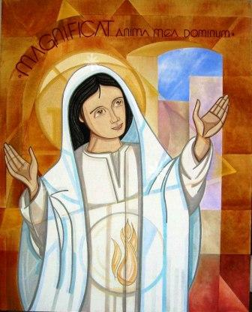
The Magnificat
My soul glorifies the Lord,
My spirit rejoices in God, my Saviour.
He looks on his servant in her lowliness;
henceforth all ages will call me blessed.
The Almighty works marvels for me.
Holy his name!
His mercy is from age to age,
on those who fear him.
Notes:
Mary’s song of praise was first sung to her cousin Elizabeth (Luke 1:46–55). It is sung daily at Evening Prayer.
This prayer or canticle (a song or chant containing words from Scripture) is a song of joy (Luke 1:46-55). In this song Our Lady is singing in her humble role as God’s servant “My soul proclaims the greatness of the Lord.” She is also singing as the Mother of God and of the Church because the hope expressed in the Old Testament is being fulfilled “even as he promised our fathers, Abraham and his descendants forever. Another element of this prayer is her declaration that “people forever will call me blessed.” The Evening Prayer of the Church said by priests and religious everyday includes the Magnificat.

Slide 32
He puts forth his arm in strength
and scatters the proud-hearted.
He casts the mighty from their thrones
and raises the lowly.
He fills the starving with good things,
sends the rich away empty.
He protects Israel, his servant,
remembering his mercy,
the mercy promised to our fathers,
to Abraham and his sons for ever. Amen.

Slide 33

Prayer to the Holy Spirit
O Come, Holy Spirit,
fill the hearts of your faithful,
and kindle in them the fire of your love.
Send forth your Spirit and they shall be created.
And you shall renew the face of the earth.
O God, who has taught the hearts of the faithful
by the light of the Holy Spirit,
grant that by the gift of that same Spirit
we may be always truly wise
and ever rejoice in his consolation.
Amen.
Notes:
In this prayer we ask the Holy Spirit to transform us as he transformed the disciples at Pentecost.

Slide 34
KS3

Slide 35
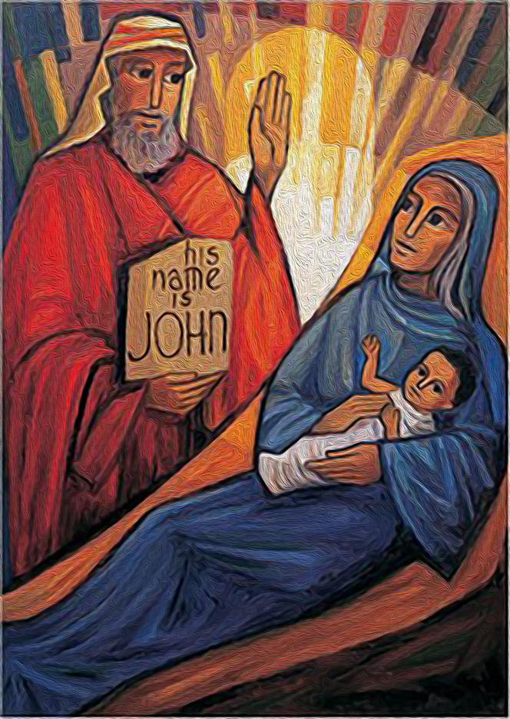
Benedictus
Blessed be the Lord, the God of Israel;
he has come to his people and set them free.
He has raised up for us a mighty saviour,
born of the house of his servant David.
Through his holy prophets he promised of old
That he would save us from our enemies,
From the hands of all who hate us.
Notes:
The Canticle of Zechariah, father of John the Baptist, is taken from Luke’s Gospel (Luke 1:68–79). It is sung daily at Morning Prayer.
This prayer or canticle (a song or chant containing words from Scripture) is the song of Zechariah, the father of John the Baptist. Zechariah is struck dumb when he refuses to believe that his wife Elizabeth is with child. It is not until the baby is born that he writes on the ground that he is to be called John. Now able to speak this song tells of God’s promise, foretold by the Old Testament prophets to send the Messiah who is to be preceded by John, the prophet who will prepare the people.

Slide 36
He promised to show mercy to our fathers
and to remember his holy covenant.
This was the oath that he swore to our father Abraham:
To set us free from the hands of our enemies,
Free to worship him without fear,
Holy and righteous in his sight all the days of our life.

Slide 37
You, my child, shall be called the prophet of the Most High;
for you will go before the Lord to prepare his way,
to give his people knowledge of salvation
by the forgiveness of their sins.
In the tender compassion of our God
the dawn from on high shall break upon us,
to shine on those who dwell in darkness and the shadow of death,
and to guide our feet into the way of peace.
Glory be to the Father, and to the Son,
and to the Holy Spirit:
as it was in the beginning, is now,
and ever shall be, world without end. Amen.

Slide 38
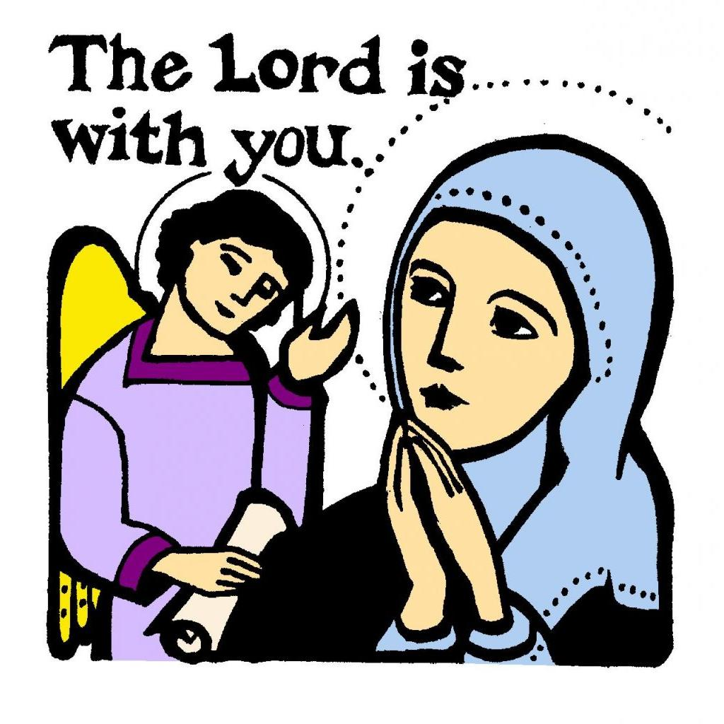
The Angelus
The Angel of the Lord declared to Mary: and she conceived of the Holy Spirit.
Hail Mary… Holy Mary…
Behold the handmaid of the Lord: be it done to me according to your word.
Hail Mary… Holy Mary…
And the Word was made flesh: and dwelt among us
Hail Mary… Holy Mary…
Pray for us, O holy Mother of God that we may be made worthy of the promises of Christ.
Notes:
The Angelus is the prayer which retells the Annunciation. The prayer is developed from the Hail Mary. Traditionally the Angelus is prayed in religious communities at particular points of the day: 6 a.m., 12 noon and 6 p.m. The religious are called to prayer by the sounding of a bell.

Slide 39
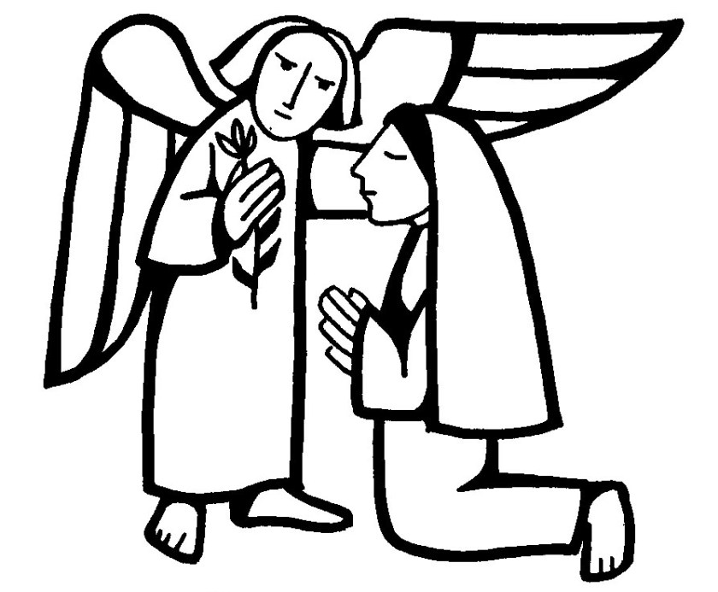
Let us pray:
Pour forth, we beseech you, O Lord,
your grace into our hearts,
that we to whom the incarnation of Christ, your Son,
was made known by the message of an angel,
may be brought by his passion and cross
to the glory of his resurrection,
through Christ our Lord. Amen.

Slide 40
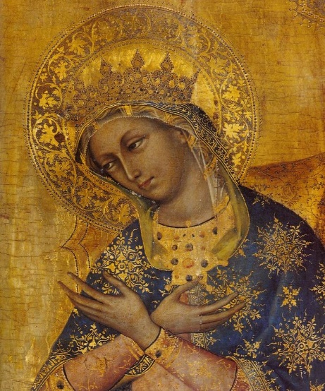
Hail Holy Queen (Salve Regina)
Hail, Holy Queen, Mother of Mercy;
Hail, our life, our sweetness and our hope!
To thee do we cry, poor banished children of Eve.
To thee do we send up our sighs,
mourning and weeping in this valley of tears!
Turn, then, most gracious Advocate,
thine eyes of mercy toward us,
and after this, our exile,
show unto us the blessed fruit of thy womb, Jesus.
O clement, O loving,
O sweet Virgin Mary.
Notes:
The Salve Regina is one of the Marian Anthems sung at Night Prayer.
In this prayer we acknowledge Mary as Queen of Heaven and as our mother too. We recognise her qualities of mercy and compassion for us. Our pray is one asking for her to intercede for us to her son, Jesus. The Hail Holy Queen (Salve Regina) is one of the night prayers of the Church.

Slide 41
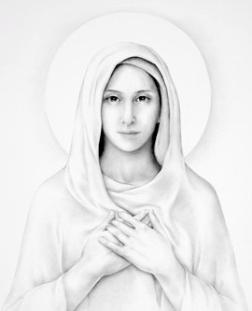
The Memorare
Remember, O most gracious Virgin Mary,
that never was it known
that anyone who fled to your protection,
implored your help or sought your intercession,
was left unaided.
Notes:
A 16th-century version of a longer 15th-century prayer.
In this prayer we acknowledge Mary’s role as intercessor between us and God. We ask that she will answer our request.

Slide 42
Inspired with this confidence, I fly unto you,
O Virgin of virgins, my Mother.
To you I come, before you I stand,
sinful and sorrowful;
O Mother of the Word Incarnate,
despise not my petitions, but in your mercy
hear and answer me.
Amen.

Slide 43
Jesus, Mary and Joseph
Jesus, Mary and Joseph, I give you my heart and my soul.
Jesus, Mary and Joseph, assist me in my last agony.
Jesus, Mary and Joseph, may I breathe forth my soul in peace with you.
Notes:
In this prayer, we acknowledge the special role of the Holy Family.

Slide 44
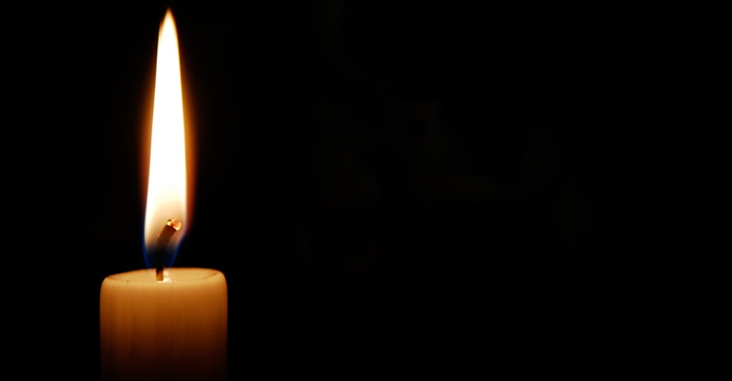
Eternal Rest
Eternal rest give unto them, O Lord,
and let perpetual light shine upon them.
May they rest in peace.
Amen.
Notes:
This prayer is for those who have died. We are asking that the dead will be with God for all eternity. It can be said on the occasion of a person’s death. It is used throughout the month of November, the month of the Holy Souls, when we remember all who have died including friends and family and those who have no one to pray for them.

Slide 45
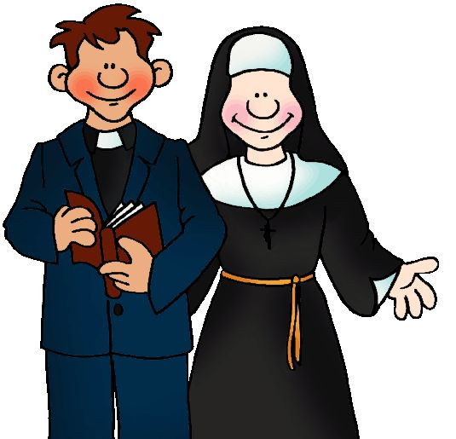
Diocesan Prayer for Vocations
Heavenly Father,
we ask you to send labourers
into your harvest.
Inspire, in the hearts of your people,
vocations to the priesthood, diaconate
and religious life.
Bless our families with a spirit of generosity,
so that those whom you call
have the courage to give themselves
to your Church in faith.
Through Christ our Lord.
Amen.
Notes:
This prayer asks for those with a vocation (a calling) to have the courage to enter into priestly ordination or religious life (religious orders). We also pray for the families of those with vocations.

Slide 46
Additional
Prayers

Slide 47
Prayer of St. Francis
Lord, make me an instrument of your peace:
where there is hatred, let me sow love;
where there is injury, pardon;
where there is doubt, faith;
where there is despair, hope;
where there is darkness, light;
where there is sadness, joy.
Notes:
Please note, this prayer was written by an anonymous author.
Make me a Channel of Your Peace is a popular prayer attributed to St. Francis of Assisi. In this prayer we ask God to help us to be peacemakers.

Slide 48
O divine Master, grant that I may not so much seek
to be consoled as to console,
to be understood as to understand,
to be loved as to love.
For it is in giving that we receive,
it is in pardoning that we are pardoned,
and it is in dying that we are born to eternal life.
Amen.

Slide 49
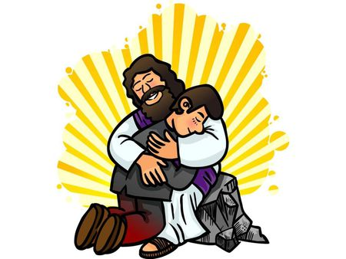
Act of Sorrow
O my God, I thank you for loving me.
I am sorry for all my sins:
for not loving others
and not loving you.
Help me to live like Jesus
and not sin again.
Amen.
Notes:
This sorry prayer can be used at any time. In it we ask God for his forgiveness. This prayer can also be used as an act of contrition during the Sacrament of Reconciliation (usually made for the first time in Y3).

Slide 50

Prayer of Thanksgiving after Communion
O Sacrament most holy!
O Sacrament divine!
All praise and all thanksgiving
be every moment thine.
Notes:
This prayer is said silently once a person has received Communion at Mass whilst they are still kneeling. It is an acknowledgment of the sanctified Christ who is now present within them in the form of the Eucharist.

Slide 51
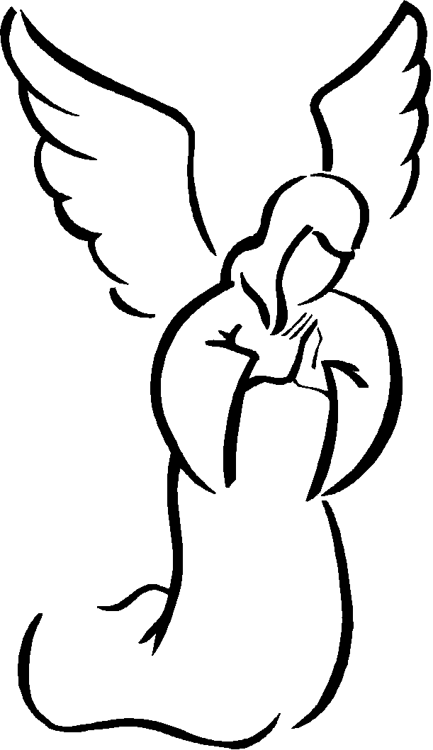
Prayer to the
Guardian Angel
Angel sent by God to guide me,
be my light and walk beside me;
be my guardian and protect me;
on the paths of life direct me.
Notes:
It is part of our belief that part of the role of angels is to watch over us. The feast of the Guardian Angels is on October 2. This is an opportunity for them to learn another version.

Slide 52
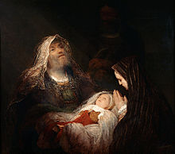
Nunc Dimittis
Now, Lord, you have kept your word:
let your servant go in peace.
With my own eyes I have seen the salvation
which you have prepared in the sight of every people:
a light to reveal you to the nations
and the glory of your people Israel.
Glory be to the Father and to the Son
and to the Holy Spirit,
as it was in the beginning, is now,
and ever shall be, world without end.
Amen.
Notes:
This prayer or canticle (a song or chant containing words from Scripture) is also known as the song of Simeon. Simeon is a worker in the temple where Mary and Joseph come to make an offering following Jesus’ birth. Simeon, an old man, has been promised by God that he would see the Messiah before he dies: Simeon recognises and acknowledges Jesus as the ‘Light of the World’.
The Presentation is commemorated on 2 Feb and all the candles to be used in Church for the following year are blessed on this day. The canticle of Simeon is part of the Liturgy of the Hours.

Slide 53
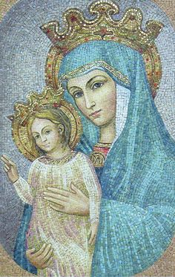
Regina Caeli
Queen of Heaven, rejoice. Alleluia!
For he whom you were made worthy to bear. Alleluia!
Has risen as he said. Alleluia!
Pray for us to our God. Alleluia!
Rejoice and be glad, O Virgin Mary. Alleluia!
For the Lord has risen indeed. Alleluia!
Let us pray;
God, who through the resurrection of your Son, our Lord Jesus Christ,
has made glad the whole world, grant us, we pray,
that through the intercession of the Virgin Mary, his mother,
we may attain the joys of everlasting life.
Through the same Christ our Lord.
Amen.
Notes:
This is an ancient hymn of the church addressed to Our Lady. In this prayer we ask Mary as Queen of Heaven to rejoice in the resurrection of Jesus. This could be linked to the tradition of Salubong in the Philippines. Salubong – (meaning ‘meeting’ or ‘encounter’) is an Easter day procession which re-enacts the Risen Christ’s reunion with his mother, Mary.

