Slide 1

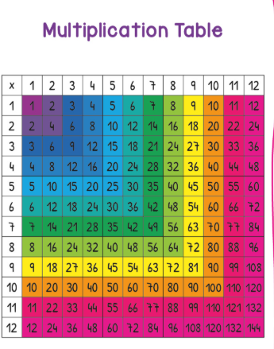
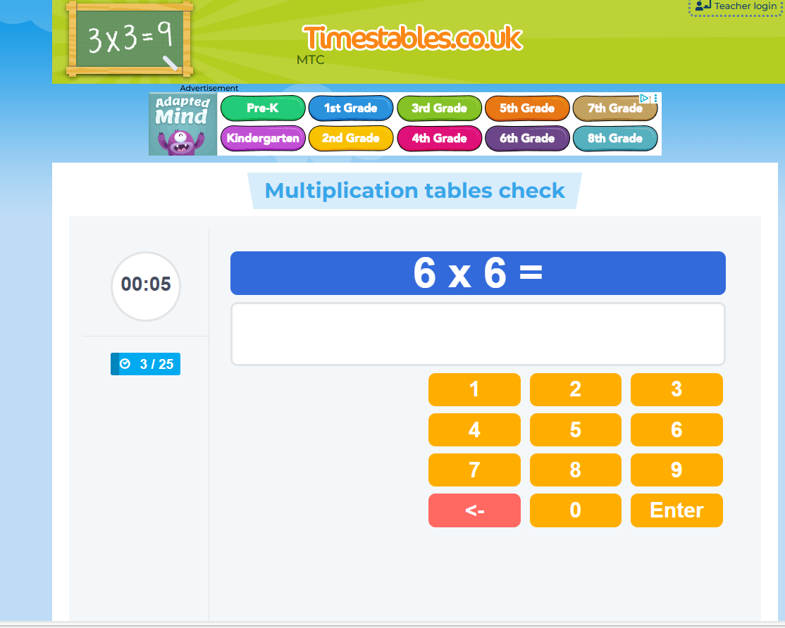
Our Lady of the Wayside
Year 4 Multiplication Tables Check (MTC)
Parent Workshop – 10 February 2026
https://www.timestables.co.uk/multiplication-tables-check/
Notes:
Welcome everyone and thank you for coming.
Tonight is about explaining the Year 4 Multiplication Tables Check (MTC), why times tables fluency matters, and how you can support your child at home in easy, low‑stress ways.
Please feel free to note questions as we go—there will be time at the end.

Slide 2
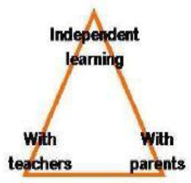
Aims
Why times tables fluency matters
What the MTC is (and what it isn't)
What your child will experience
How school prepares children
How you can help at home (simple routines)
Questions
We're here to support you and your child every step of the way.
Notes:
Here’s the plan for this evening.
We’ll look at why times tables are important, what the MTC is and what it looks like for children.
Then I’ll share what we do in school at Our Lady of the Wayside and simple home routines and games.
We’ll finish with questions.

Slide 3
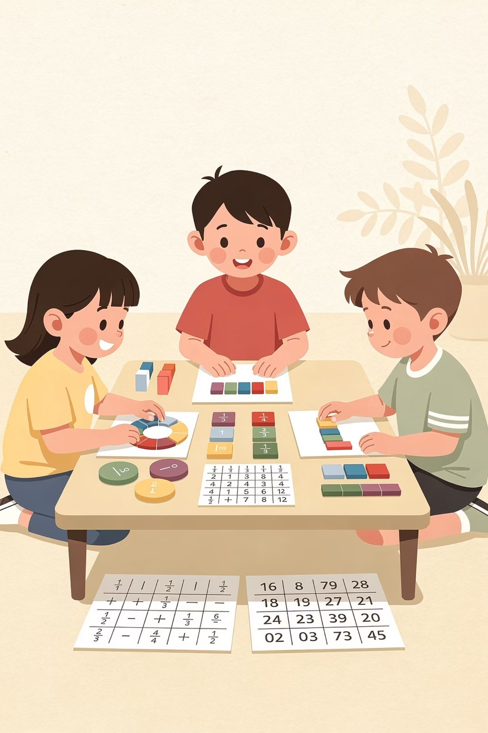
Why Times Tables Matter
Foundation Skills
Confidence
Builder
Supports
Fractions
Division
Written multiplication
Area
Mental Maths
requires quick recall of multiplication and division facts
Problem-Solving
Helps children
focus on
problem-solving
Builds
Confidence
and speed
Less thinking about facts means
more thinking about maths.
Fluent recall = quick answers without counting.
Notes:
Times tables fluency supports so much of the maths curriculum.
When children recall facts quickly, they can focus on the harder thinking—fractions, division, written methods, and problem solving.
This is about confidence, not pressure or racing.

Slide 4
What "Knowing" Them Means
Examples
Recall facts out of order
7 × 8 = 56
8 x 7 = 56 and
Not just chanting in sequence
Answer within a few seconds
56 ÷ 7 = 8
56 ÷ 8 = 7
Quick, confident responses
Know linked division facts
Understanding the connection
Chanting is a start; we aim for quick random recall.
Notes:
‘Knowing’ a table means answering facts out of order, not just chanting.
We also link facts into families, including division facts.
Chanting is a good start, but we aim for quick, accurate recall.

Slide 5
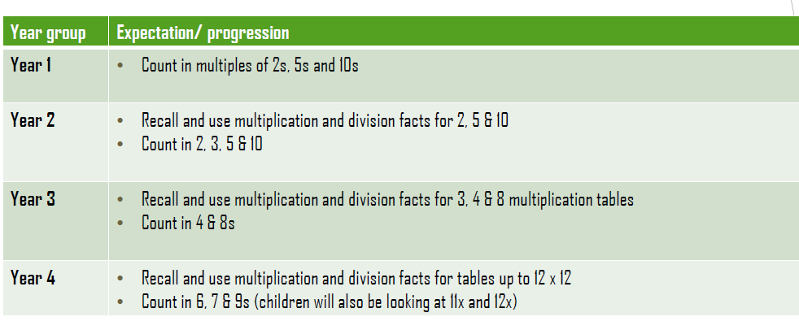
Times tables -Expectation and progression from National Curriculum

Slide 6
Why the times table check?
The purpose of the check is to determine whether pupils can fluently recall their times tables up to 12, which is essential for future success in mathematics.
It will also help your child’s school to identify pupils who may need additional support.

Slide 7
What is the MTC?
1
2
3
4
Online check for
Year 4
25 multiplication questions
6 seconds per
question
About 5 minutes
total
Taken on a computer
or tablet
Plus 3 practice questions to start
Time to think and type
Quick and focused
5
June 2-week window
School chooses the day
This is a short, calm check in familiar conditions.
We practise the format so children know exactly what to expect.
Notes:
The MTC is a short on‑screen check taken in Year 4.
There are 25 questions, plus 3 practice questions first.
Each question lasts 6 seconds and the whole check is about 5 minutes.
It checks multiplication fact recall—children type answers; they don’t show written methods.

Slide 8
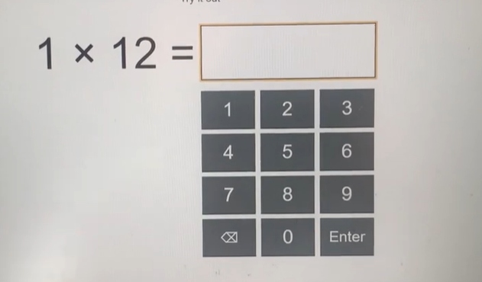
What It Looks Like
01
One question at a time
Screen shows: __ × __ =
02
Child types the answer
Using the keyboard or number pad
It's like quick-fire recall, not written methods. Children simply type the answer they know.
03
Timer runs each question
6 seconds to respond
Notes:
Children see one multiplication question at a time and type the answer.
We practise the format in school so it feels familiar.
If a question is missed, children simply move on—one question doesn’t define the result.

Slide 9

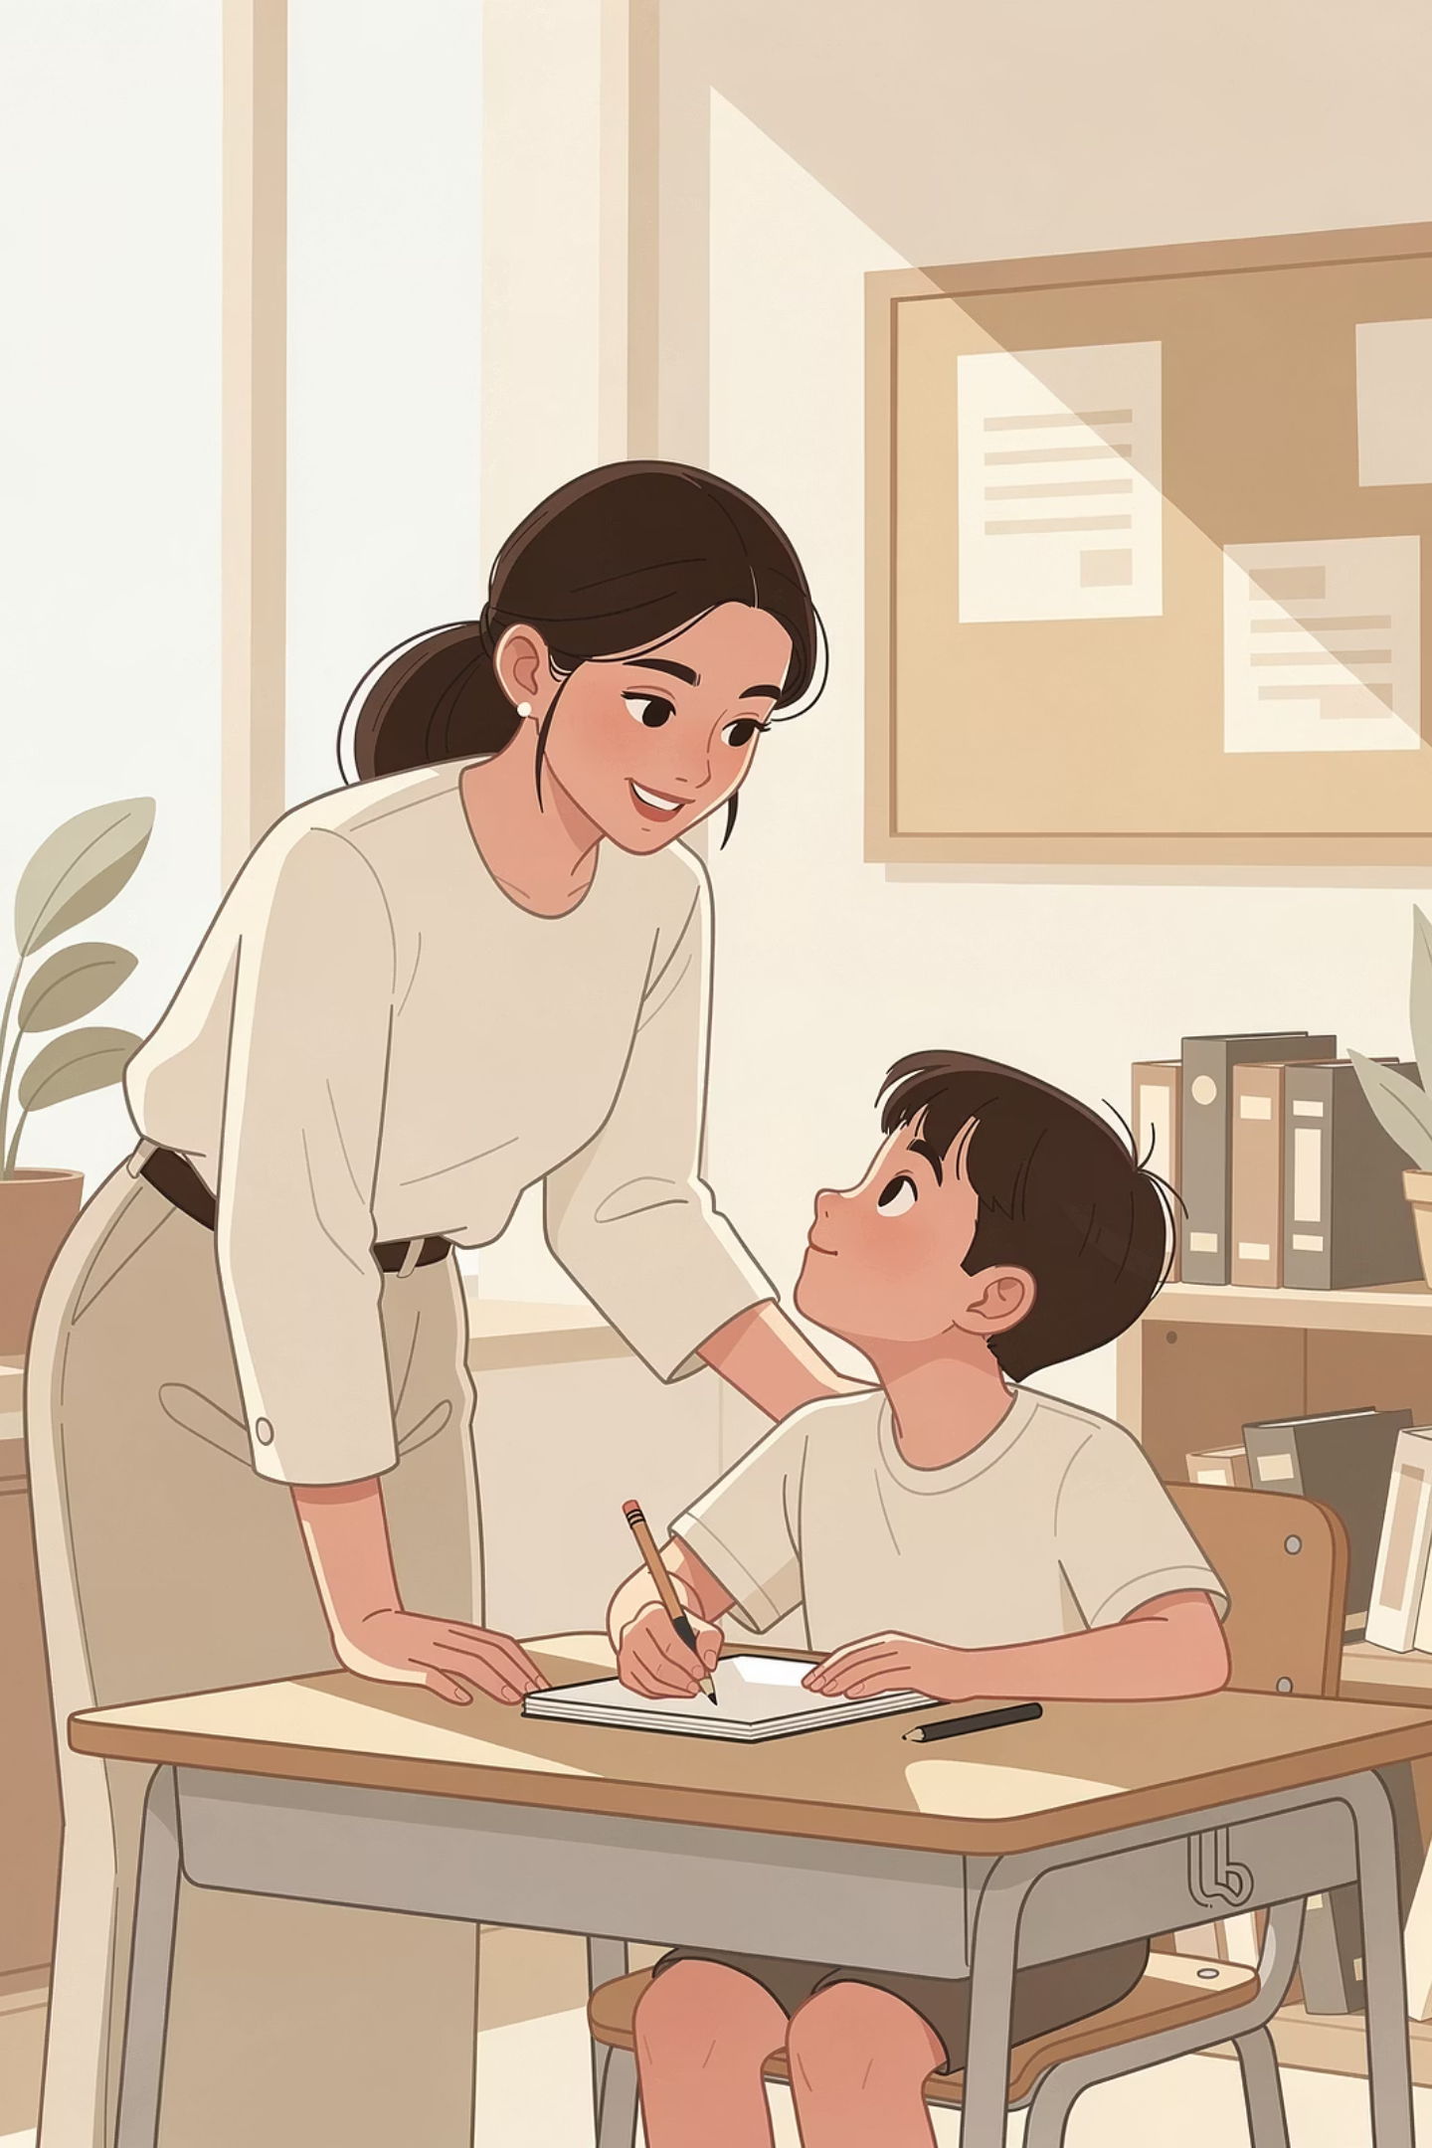



Reassurance & Support
We practise little-and-often
Regular, short sessions build familiarity
It's normal to feel a bit nervous
We acknowledge feelings and build confidence
We build confidence through games and routines
Fun, engaging practice every day
Support and adaptations are available
where appropriate
We ensure every child is supported
This is about wellbeing and confidence, not high stakes. We're here to help every child succeed.
Notes:
We want every child to feel calm and supported.
Access arrangements can be used where appropriate, following guidance.
Our priority is confidence and steady improvement.

Slide 10




How We Prepare at Our Lady of the Wayside
Daily/regular short practice in class
Focus on trickier
facts
Games, partner quizzes, and quick recall bursts
Regular low-stakes practise checks
6, 7, 8, 9, 12 times
tables
Built into our routine
Making practice
engaging
Familiarising with
the format
We describe classroom routines in friendly terms
and keep everything positive and encouraging.
Notes:
In school we practise little‑and‑often with lots of encouragement.
We use games, partner quizzes, chanting, and quick recall activities.
We also target commonly tricky facts (6, 7, 8, 9, 12) and celebrate progress.

Slide 11
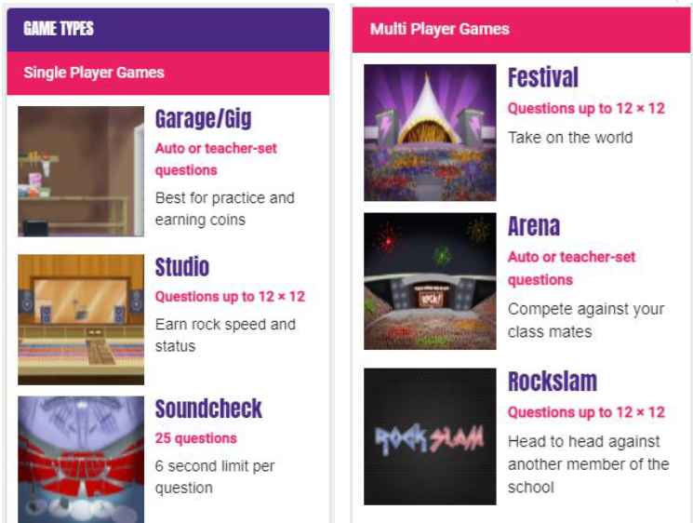
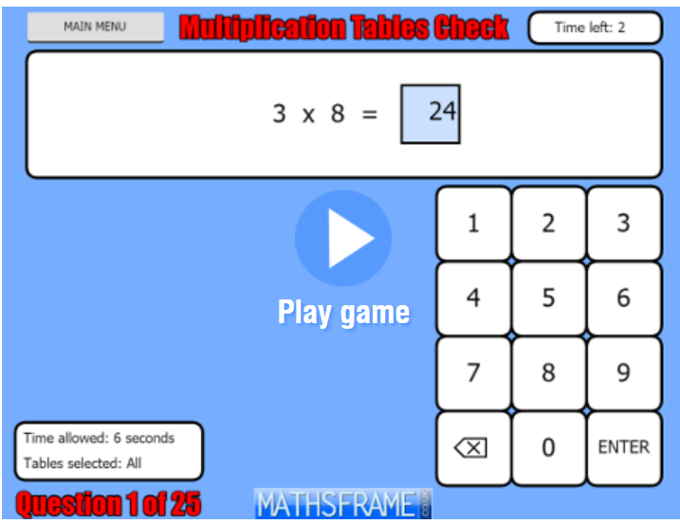

Online Practice We Use
Online tools your child will recognise
TT Rockstars
MathsFrame
Speed + accuracy in a fun format
Times tables practice games
Multiplication Tables Check - Mathsframe
We explain how often is ideal and how to keep it positive.
Little and often is the key to success.
Mini tip: Short sessions (5–10 mins) work best.
Notes:
These are the main online tools we use.
MathsFrame provides quick games for specific tables and mixed practice.
TT Rockstars builds speed and accuracy.
Short sessions—5 to 10 minutes—work best. The aim is consistency.

Slide 12
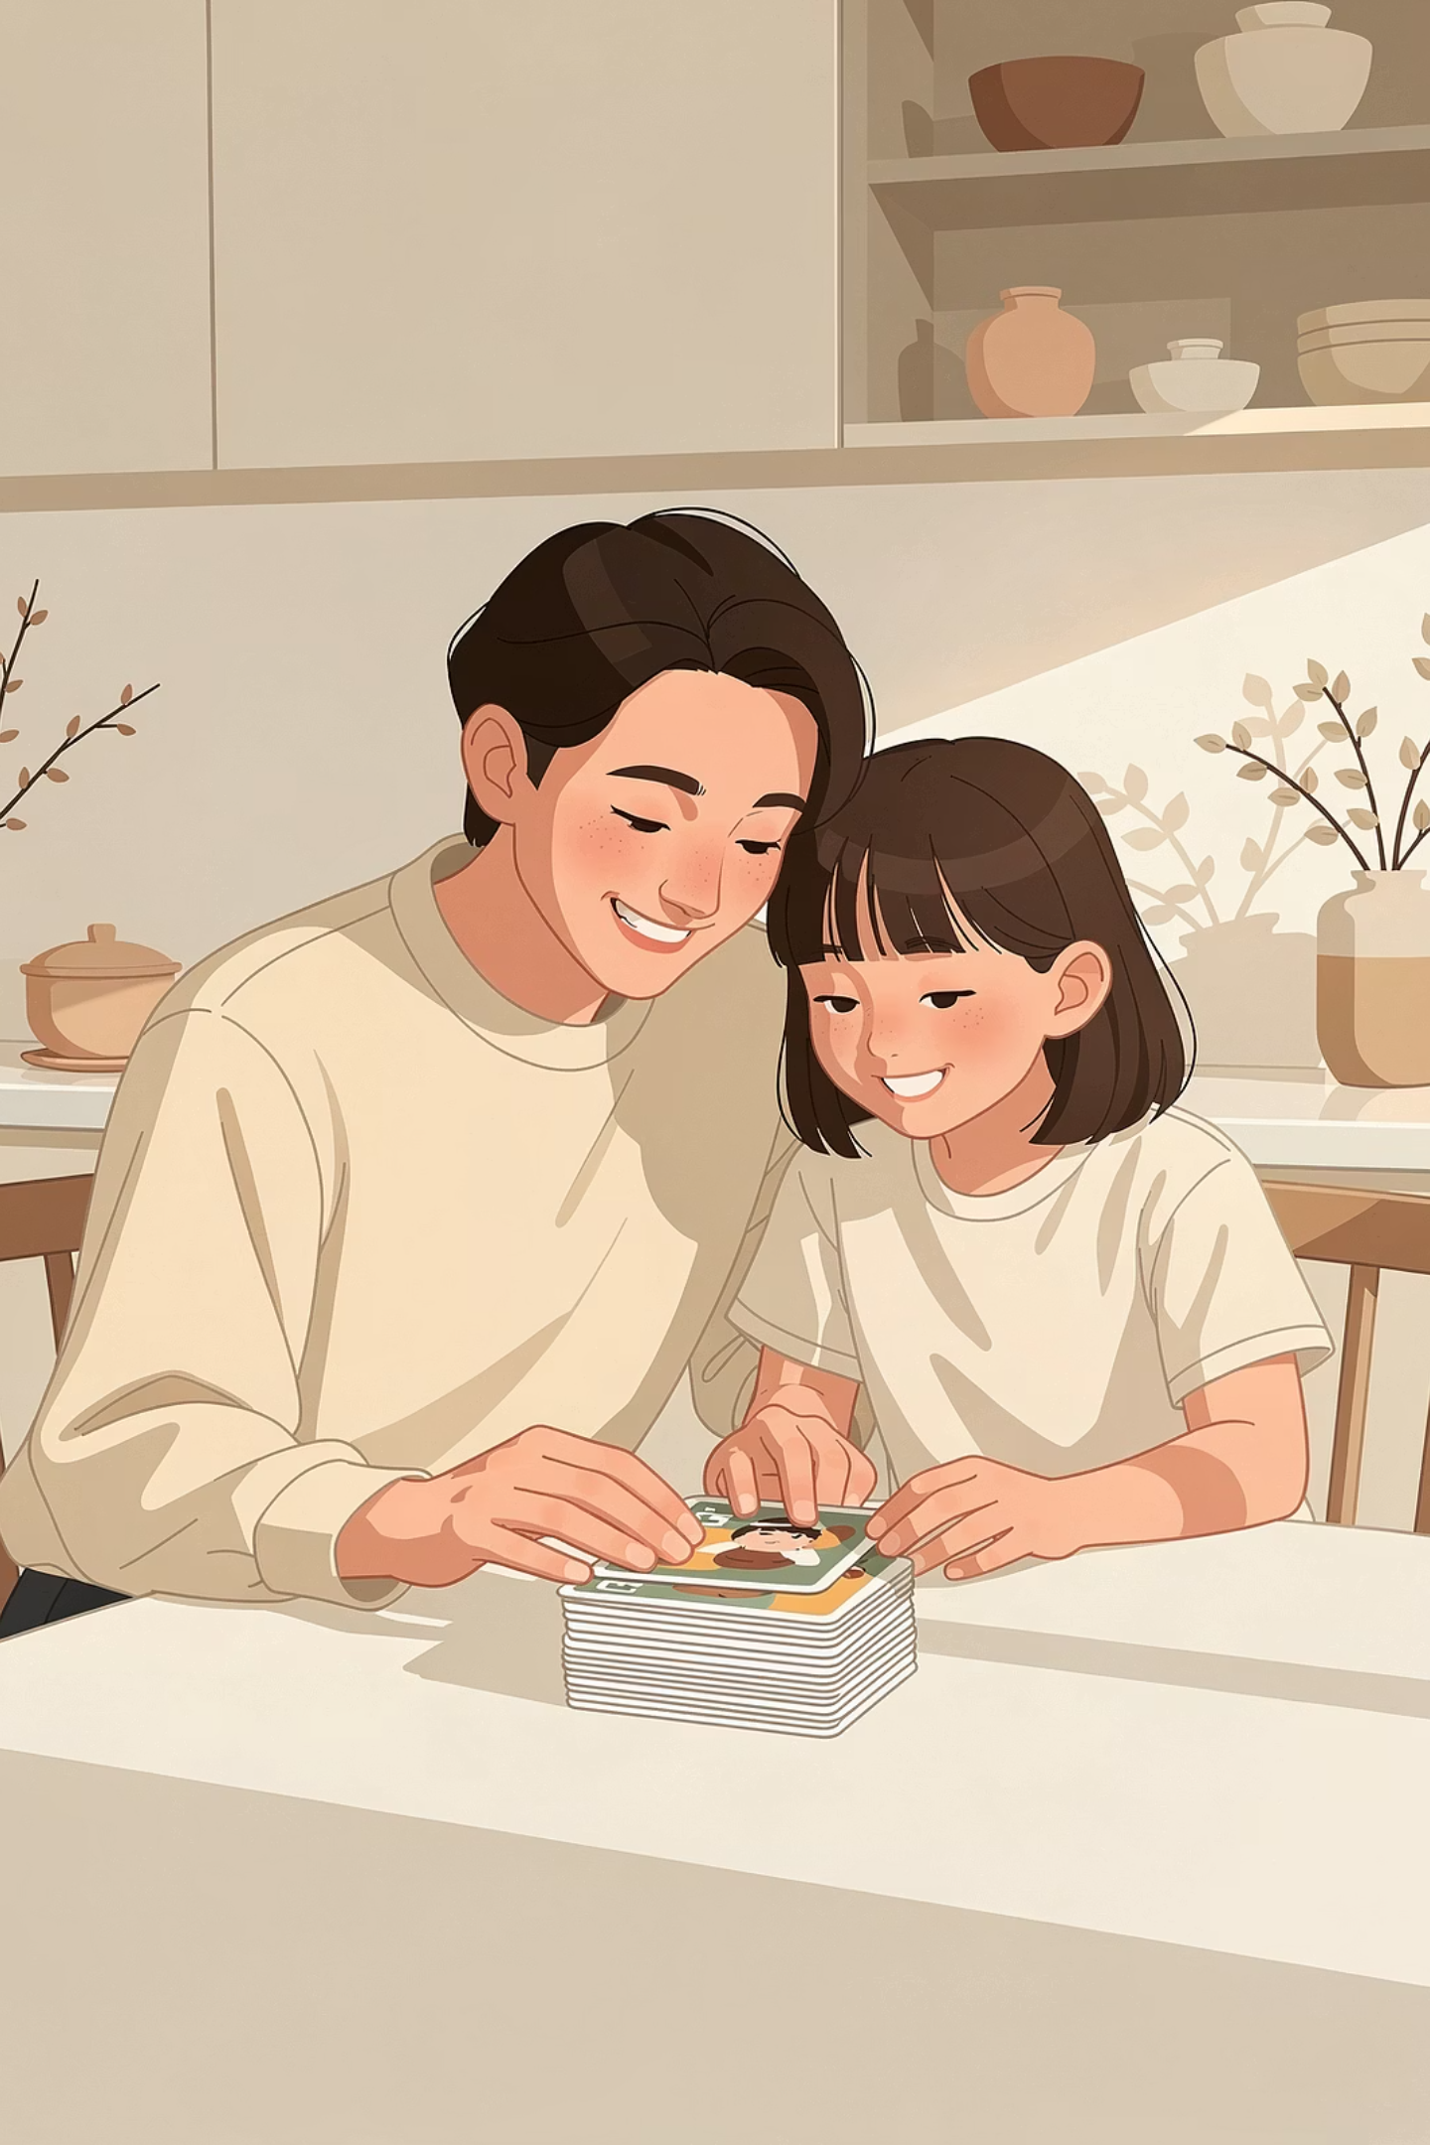
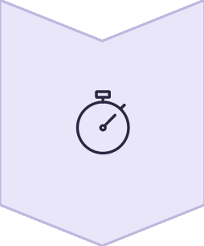
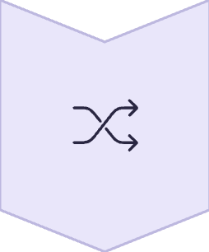

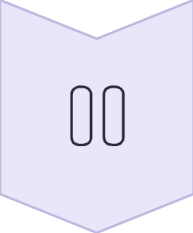
Home Practice: 5–10 Minutes a Day
Keep it short and regular
Consistency matters more than length
Mix chanting + random recall
Variety keeps it interesting
Praise effort and improvement
Celebrate progress, not perfection
Stop if frustrated—try again later
Keep it positive always
It’s important for "little and often", not long battles. This should never feel like a chore.
Notes:
Talk through the key points on the slide and keep the message reassuring and practical.
Invite parents to save questions for the end.

Slide 13
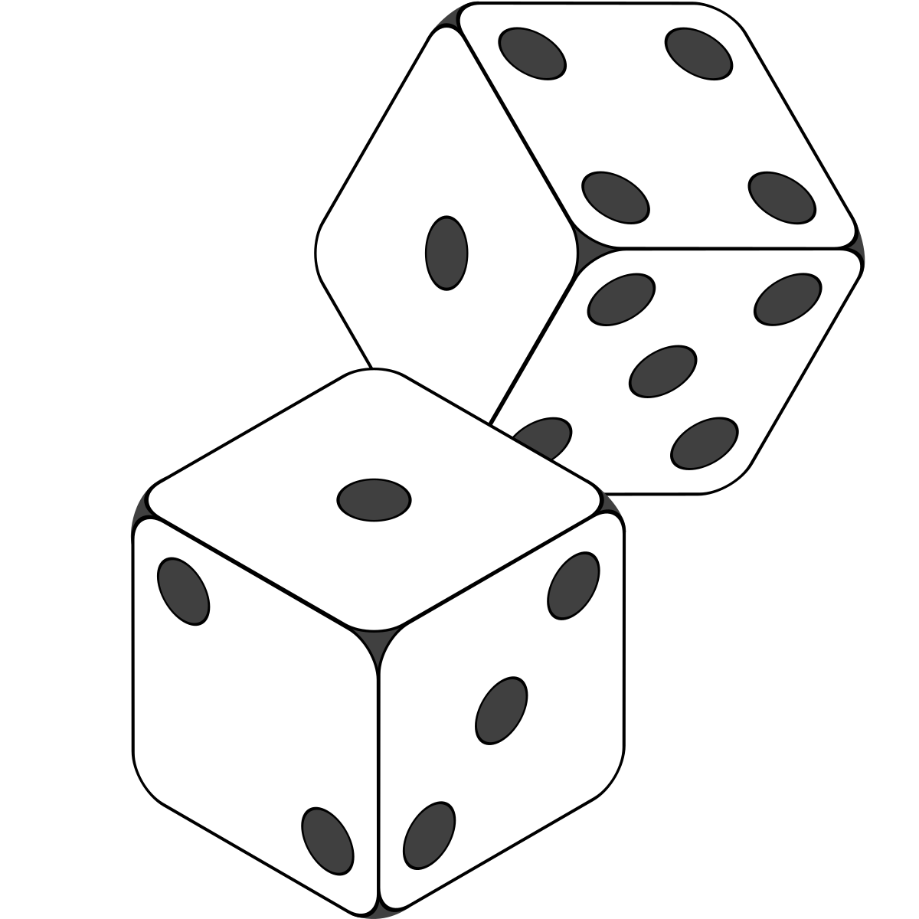
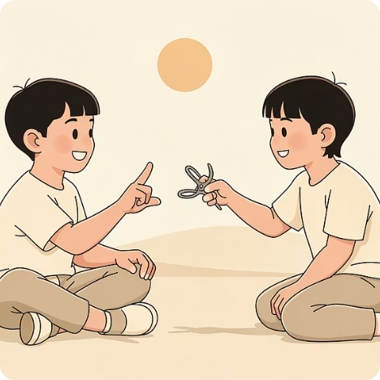
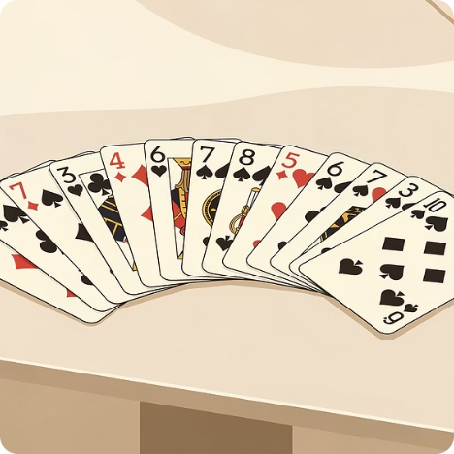
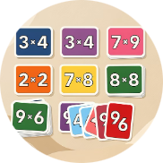
Fun, No-Prep Games We Use
Quick games (2–5 minutes)
Dice
Rock–Paper–Scissors
Playing cards
Uno
Use dice to generate numbers for multiplication battles. Two dice can be rolled at once to create all questions up to 12
Players show a number of fingers, and the first to multiply them wins.
Match times table facts (e.g., pick a target table and answer before placing)
Flip two cards → multiply (J=11, Q=12 OR remove face cards)
Give one worked example for each game and remember: keep it fun!
Notes:
Here are some quick, fun games you can use at home.
Playing cards: flip two cards and multiply—remove face cards or use J=11 and Q=12.
Uno: choose a target table; answer a fact before placing a card.
Counting sticks: build equal groups/arrays so children can ‘see’ the multiplication, then recall the fact.
Rock–paper–scissors: the winner asks a times‑table question—first to 10 points wins.
Keep games short and upbeat—stop while it’s still fun.

Slide 14
More ideas to help
Power Towers: Write problems on cups and answers inside. Correct answers allow building a tower.
Fact cards: Create a set of cards with a question on one side of the card( 6x5=) and the answer on the reverse(30).Read the question and then turn over to see the answer. Try and say the answer before you turn over. When familiar with the multiplication table, shuffle the cards and answer in a random order.
Active Games: "Times Tables Jump" – skip, hop, or jump while chanting tables.
Online/Apps: 10 Minutes a Day Times Tables, Quick Maths, and Mathopoly.
Bingo: Use multiplication bingo cards for 6, 7, 8, and 9 times tables.
"I Have...Who Has?": A chain game that requires mental maths recall.
Quick Questions Anywhere!
on the way to school
in advert breaks
whilst getting dressed
a few before bed

Slide 15
Other Online Resources
There are many free multiplication and division games available online.
Here are a few places to get you started:
www.multiplication.com www.coolmath-games.com
http://www.oswego.org/ocsd-web/games/Mathmagician/mathsmulti.html http://www.transum.org/Tables/Times_Tables.asp
www.tablestest.com www.mathletics.co.uk
Apps: 10 Minutes a Day Times Tables, Quick Maths, and Mathopoly.

Slide 16
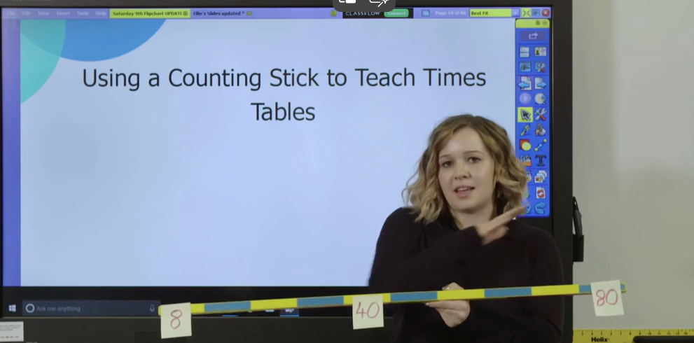

Resources on You Tube
Use a counting stick
Timetable songs and raps
Three Times Table Song (Cover of Uptown Funk by Mark Ronson and Bruno Mars)
How To Use A Counting Stick To Teach Times Tables

Slide 17
Common Questions + How to Help
"My child panics with timers"
"They can chant but not answer randomly"
"What should we focus on?"
Solution: Practise gently, build speed gradually. Start without timers, then introduce them slowly.
Solution: Use flashcards/random questions. Mix up the order to build true fluency.
Solution: Ask teacher which tables are priority. We can give personalised guidance.
Notes:
Thank you for coming.
What questions do you have?
If you’d like personalised guidance—especially on which tables to prioritise—please speak to us afterwards.

Slide 18
Any Questions?
We're here to help
This is a partnership between home and school.
Please speak to your child's teacher if you'd like personalised tips
Notes:
Thank you for coming.
What questions do you have?
If you’d like personalised guidance—especially on which tables to prioritise—please speak to us afterwards.

Slide 19
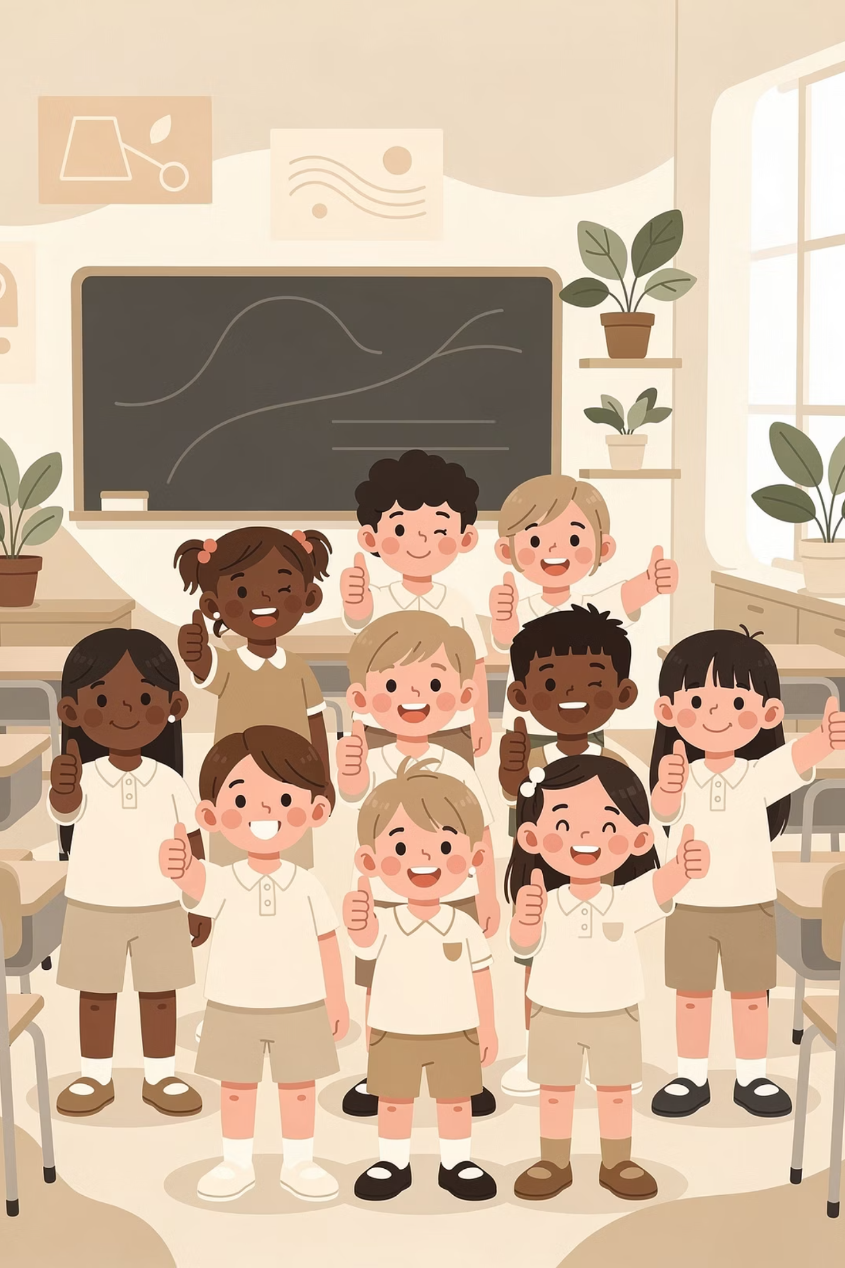
Thank You!
Working together to support your child's learning
Notes:
Thank you for coming.
What questions do you have?
If you’d like personalised guidance—especially on which tables to prioritise—please speak to us afterwards.

