Slide 1
Purpose of Meeting
Share information regarding 2027 SATs
Share information regarding Dol-Y-Moch residential
Answer any questions you may have

Slide 2
A Guide to Year 6 National Assessments 2027
Monday 10th May - SPaG Paper
  Spelling – 20 minutes
  Spelling, punctuation and grammar paper - 45 minutes
Tuesday 11th May - Reading Paper – 60 minutes
Wednesday 12th May - Arithmetic Paper 1 – 30 minutes
  Reasoning Paper 2 – 40 minutes
Thursday 13th May - Reasoning Paper 3 – 40 minutes
No tests on Friday.
We aim to give the children toast about 8.45 and start around 9.00/9.15am

Slide 3
Paper Expectations
Spelling – out of 20 spellings – not timed
SPAG – out of 50 (70 in total) marks – 45 minutes to answer all
Reading – out of 50 marks - 3 texts (often two-sides of A4 alongside questions) – 60 minutes!
Arithmetic – out of 40 marks – 36 questions – 30 minutes!
Reasoning 2 and 3 – out of 35 marks – 40 minutes to complete

Slide 4
What are SATs?
SATs are statutory attainment tests for all Year 6 pupils in England.
There is no writing test, writing is teacher assessed. Teacher assessments are subject to external moderation.

Slide 5
How are other subjects assessed?
Attainment for the rest of the curriculum is assessed through on-going teacher assessment. Pupil’s attainment and progress is reported through parent’s evening, pupil report cards and annual school reports.
Which children have to take the tests?
All children who are in their final year of primary education, unless the school has assessed that pupil as working below the standard of the national curriculum.

Slide 6
Are there arrangements in place to support children with additional needs?
National tests are intended to assess pupils’ abilities in a fair and comparable way. Access arrangements may be appropriate for pupils:
• with an education, health and care (EHC) plan
• for whom provision is being made in school using the SEN Support system
• whose learning difficulty or disability significantly affects their ability to access the tests
The support given during the tests must never advantage or disadvantage individual pupils. A school must have evidence that the support provided is based on normal classroom practice.

Slide 7
What happens if my child is absent during the test period?
Pupils who miss one or more of the tests papers in a subject, through illness or for any other reason, are recorded as absent for the whole subject.
If your child is likely to be absent, please contact school immediately.
How are the test papers marked?
Test papers are put into sealed bags and posted to approved markers. School has no contact with these markers.
A selection of all the markers papers are second marked for monitoring purposes.
Schools can request a review where there are marking errors but only if it makes a change to expected standard.

Slide 8
When will the children receive their marks?
Results are published to schools in July.
All results are reported to parents.
Teachers will meet pupils individually to discuss their results with them.
How are the marks used by secondary schools?
We have a statutory obligation to report results to your child’s secondary school. Each secondary school will use these results in different ways. We also send TA results to your child’s secondary school.

Slide 9

Helping your child to prepare:
Purchase the CGP books (letter to follow)
Repetition - short bursts of work continually throughout the year.
MyMaths
Spag.com
BBC Bitesize
Practise Year 3/4/5/6 common exception words
Reading at home daily
Support with homework
Please avoid doing previous SATs papers as we use these for baseline/summative assessment purposes throughout the year.

Slide 10
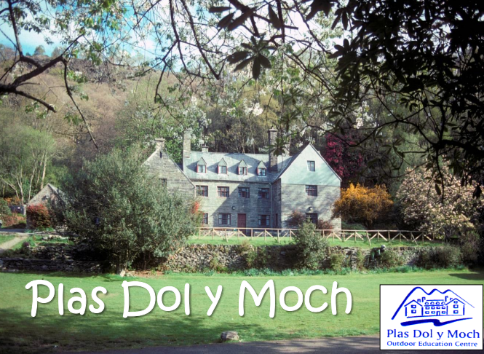
DOL-Y-MOCH
Y6 residential Friday 21st to Monday 24th May 2027

Slide 11
Where is Dol-y-Moch?
Dol-y-Moch is a residential Outdoor & Adventure Education Centre based in the heart of Snowdonia, North Wales, owned and operated by Coventry City Council.
They have been delivering high quality Outdoor Education and Adventure courses since 1966.
All adventure activities are delivered by highly competent and trained teachers/instructors. Staff delivering activates are assessed under nationally recognised award schemes or by technical experts in their field.
All staff have extensive local knowledge of the areas around Dol-y-Moch used for activities and are qualified first aiders.
Staffing ratio – 1:10
Staff attending: TBC

Slide 12
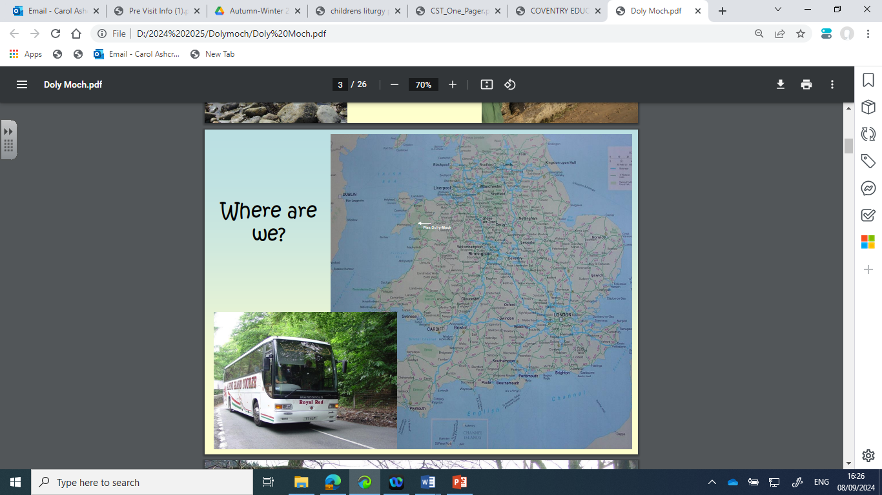

Slide 13
What activities will your child be participating in?
River Walk – Children will follow the course of a river learning about its features e.g. source, meanders, flood plain, etc ending up at the beach.
Criccieth Beach – Children will learn about coastal erosion
Beach Scrambling
Canoeing
Hiking
Assault Courses

Slide 14
What if your child is worried about doing an activity?
The aim is to challenge each participant to provide them an opportunity to develop key skills and learn about themselves, however they will not force participants to do things they don't want to.
The teaching/instructional team are expert at tailoring activities to the groups abilities to maximize opportunities for challenge and success.
They encourage everyone to have a go as we know they feel so proud when they do, especially if they have overcome a fear.

Slide 15
Are activities cancelled if the weather is bad?
All the activities can take place in a range of weather conditions.
All students are provided appropriate clothing for each activity such as waterproofs, wellies, warm fleeces, or wetsuits.
An assessment of the day’s activities is undertaken each morning before setting out, taking into consideration the groups needs/abilities, aims and prevailing weather conditions to ensure appropriate activities take place each day.

Slide 16
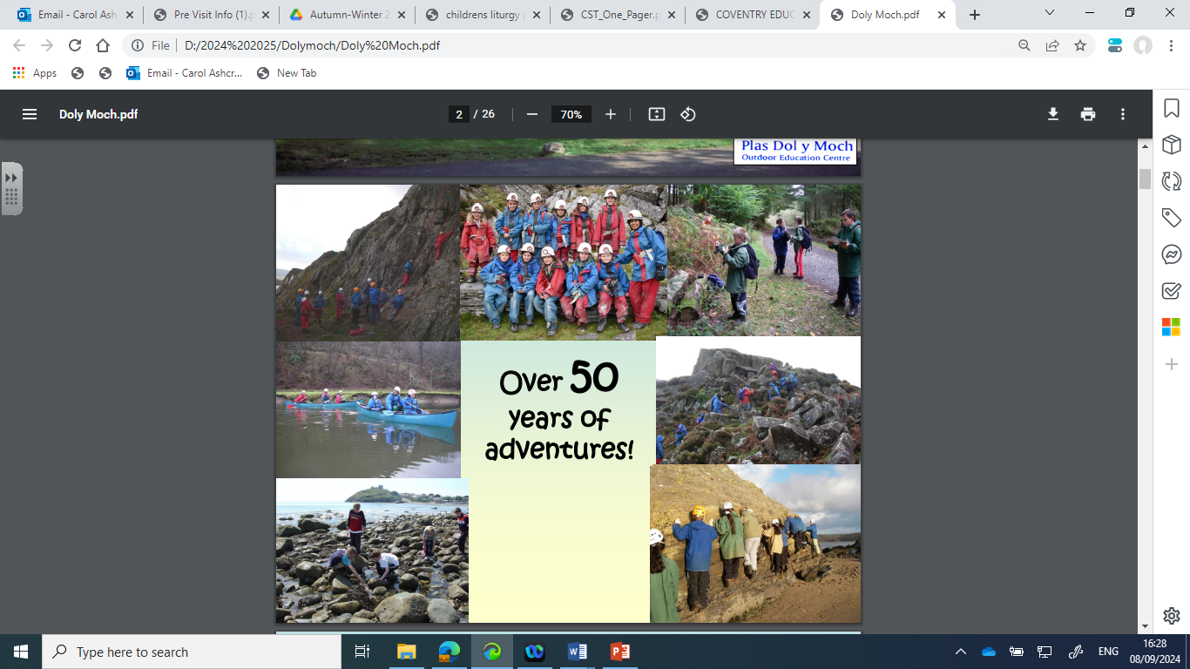

Slide 17
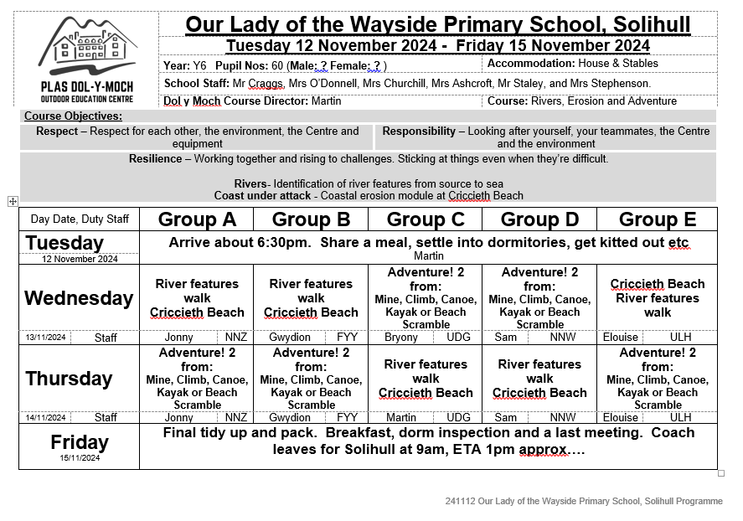
What is the timetable?

Slide 18
What are the facilities ?
Pupils will be accommodated in dormitories, predominantly with bunk beds in either The Stables or The House.
There are sufficient showers and toilets throughout for pupils, together with drying rooms to help dry the inevitable wet kit! Please label all clothes.
All bedding is provided; however group members do need to bring their own towels.
Supervised by school/staff, there are plenty of grounds around the Centre for pupils to play in the evening. There are fields to run around or play football in, a basketball court and common room (with some indoor games) to keep students occupied in the very limited amount of free time available during their visit.

Slide 19
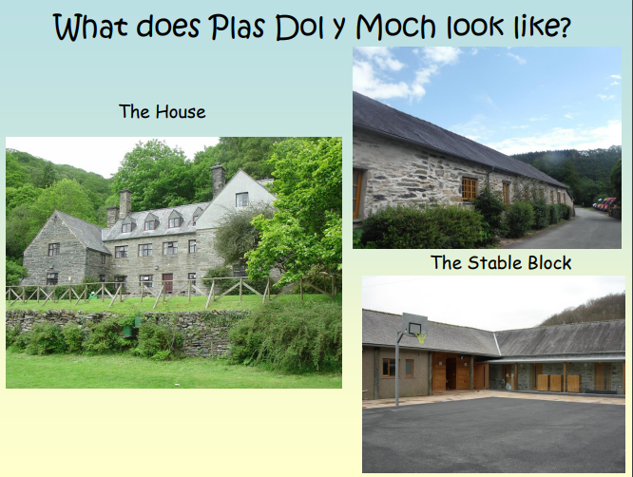

Slide 20
What will Dol-y-Moch provide?
Dol-y-Moch will provide all technical and safety kit/equipment for all activities undertaken (e.g. helmets, harness, wetsuit etc). Participants will also be provided with a:
- set of waterproofs (tops & bottoms)
- warm fleece
- windproof
- rucksack
- water-bottle
- wellies/boots

Slide 21
How do the children get to
Dol-y-Moch?
Departure - Children are collected by coach at 2pm.
Stop - at Telford Services (snack and toilet break)
Arrival – approximately 6:30pm
Dates: Friday 21st May to Monday 24th May 2027

Slide 22
What happens on arrival?
Welcome/induction by Martin, the course director
Aims/Objectives
Rules/Expectations
Meal
Settle into rooms (children make own beds!)
Get kitted out
Fire Drill

Slide 23
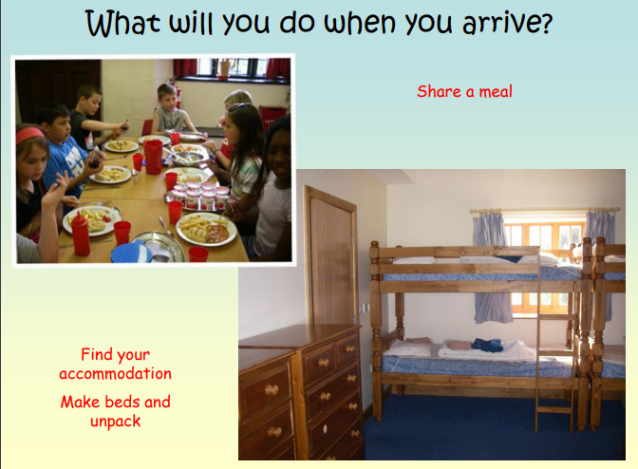

Slide 24
The Three Rs
Resilience through genuine outdoor adventure activities in the great outdoors every day.
Responsibility; through taking care of the Centre (such as keeping beds and dormitories tidy!), any equipment issued to course members, listening and following instructions.
Respect; by looking after each other, and spending plenty of time outside in the wonderful Snowdonia National Park.

Slide 25
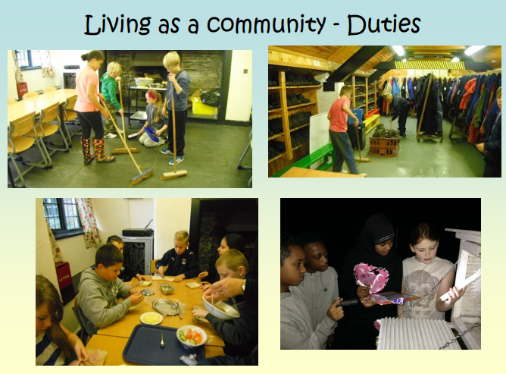

Slide 26
Departure
Friday 17th May 2027
Final tidy up and pack
Breakfast
Dorm inspection
Last meeting
Coach leaves for Solihull at 9am
ETA 1pm approx.

Slide 27
What is the cost of the residential?
£ 309 – includes transport, accommodation, food and all activities
Payment extended to 25th October
Spending money – no more than £15
We appreciate the financial challenges faced by families. Please contact Mrs Lloyd, our Family Support Worker, who will be able to advise you.

Slide 28
Medication
Please collect and complete a medication form from school office if your child will need medication (or may require medication) while they are aware; this includes travel sickness medication. Please hand in medication to your child’s class teacher before departure.
If your child has regular prescribed medication, please arrange a meeting with your child’s class teacher prior to the residential taking place.
Children who have reliever inhalers should keep these on them and not hand them in to a member of staff.

Slide 29
Photo/Filming Consent
During your son/daughter’s course, Dol-y-Moch would like to take photographs and video recordings. If appropriate, they would like to make use of these photos/videos for displays around the Centre, on their (including Coventry Outdoors & Coventry City’s) website, presentations, our social media presence, or other print and digital marketing materials.
We will also update lots of Instagram!
Please complete a photo/filming consent form either giving or withdrawing consent.

Slide 30
Please feel free to stay behind if you have any questions ☺

