Slide 1
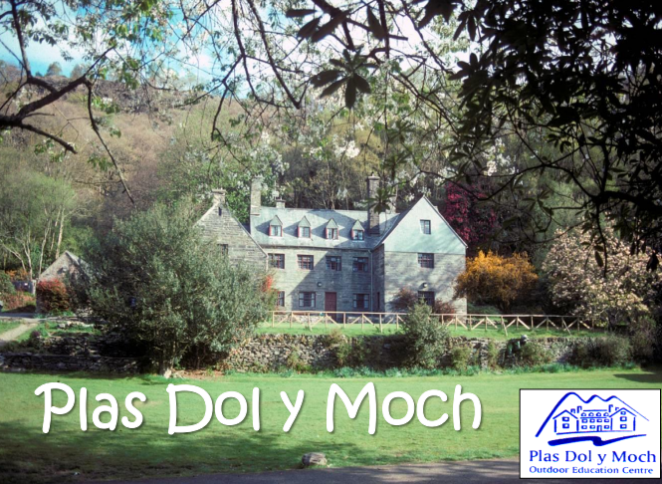
DOL-Y-MOCH
Y6 residential 21st to 24th May 2027

Slide 2
Where is Dol-y-moch?
Dol-y-Moch is a residential Outdoor & Adventure Education Centre based in the heart of Snowdonia, North Wales, owned and operated by Coventry City Council.
They have been delivering high quality Outdoor Education and Adventure courses since 1966.
All adventure activities are delivered by highly competent and trained teachers/instructors. Staff delivering activates are assessed under nationally recognised award schemes or by technical experts in their field. All staff have extensive local knowledge of the areas around Dol-y-Moch used for activities and are qualified first aiders.
Staffing ratio – 1:10
Staff attending: TBC

Slide 3
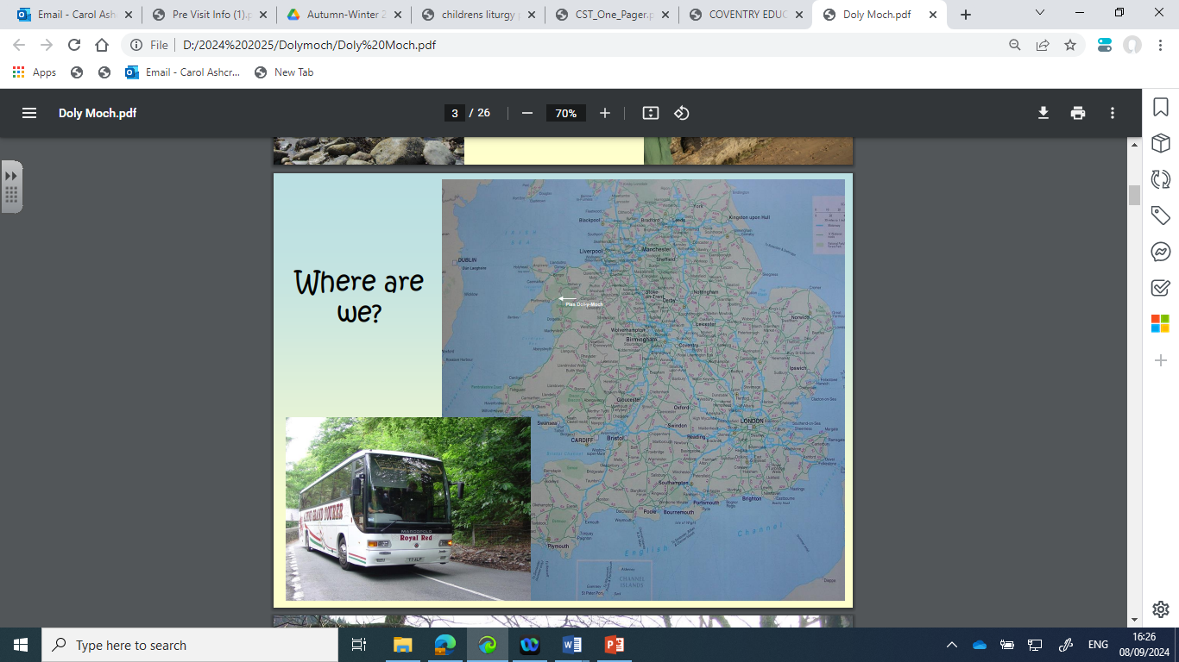

Slide 4
What activities will your child be participating in?
River Walk – Children will follow the course of a river learning about its features e.g. source, meanders, flood plain, etc ending up at the beach.
Criccieth Beach – Children will learn about coastal erosion

Slide 5
Kayaking / Canoeing
Kayaking / Canoeing is a great activity to teach personal skills, teamwork, communication and resilience as well as the water cycle, river valleys and river life. Participants always wear buoyancy aids, and if appropriate helmets.

Slide 6
Climbing / Abseiling
There is a variety of rock-climbing venues suitable to challenge all within a short distance of the Centre. Climbing is a great activity to teach responsibility, trust, teamwork, communication, determination, and resilience, as well as geology, erosion, friction, forces, and balance. Participants always wear a harness and helmet, and are safeguarded by ropes for these activities.

Slide 7
Beach Scramble
Beach Scrambling involves students climbing along sea cliffs, above shallow water or sand. This is a more dynamic activity better suited to colder days (and those who want to see the beach!) Beach scrambling helps develop teamwork, commitment, and communication skills as well as opportunities to learn about the coastal environment, tides, and sea life.

Slide 8
What if your child is worried about doing an activity?
The aim is to challenge each participant to provide them an opportunity to develop key skills and learn about themselves, however they will not force participants to do things they don't want to. The teaching/instructional team are expert at tailoring activities to the groups abilities to maximise opportunities for challenge and success. They encourage everyone to have a go as we know they feel so proud when they do, especially if they have overcome a fear.

Slide 9
Are activities cancelled if the weather is bad?
All the activities can take place in a range of weather conditions.
All students are provided appropriate clothing for each activity such as waterproofs, wellies, warm fleeces, or wetsuits.
An assessment of the day’s activities is undertaken each morning before setting out, taking into consideration the groups needs/abilities, aims and prevailing weather conditions to ensure appropriate activities take place each day.

Slide 10
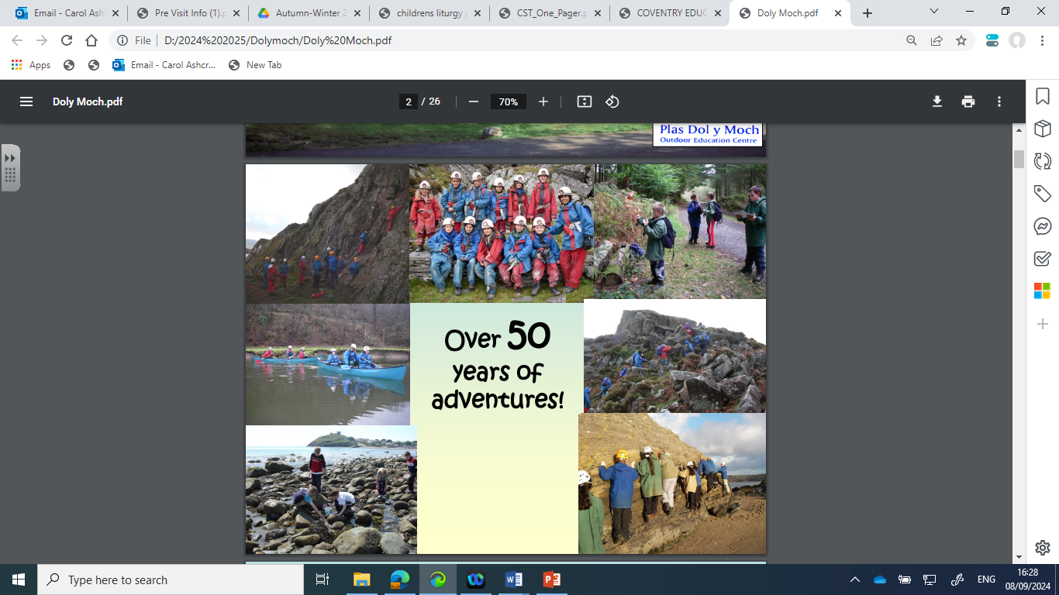

Slide 11
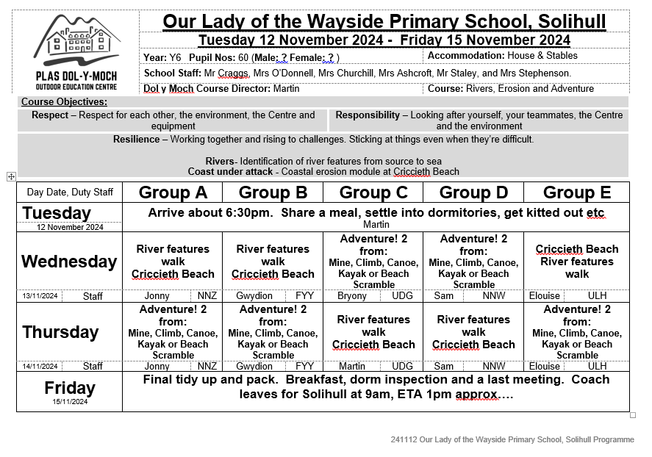
What is the timetable?

Slide 12
What are the Facilities ?
Students will be accommodated in dormitories, predominantly with bunk beds in either The Stables or The House.
There are sufficient showers and toilets throughout for pupils, together with drying rooms to help dry the inevitable wet kit! Please label all clothes.
All bedding is provided; however group members do need to bring their own towels.
Supervised by school/staff, there are plenty of grounds around the Centre for pupils to play in the evening. There are fields to run around or play football in, a basketball court and common room (with some indoor games) to keep students occupied in the very limited amount of free time available during their visit.

Slide 13
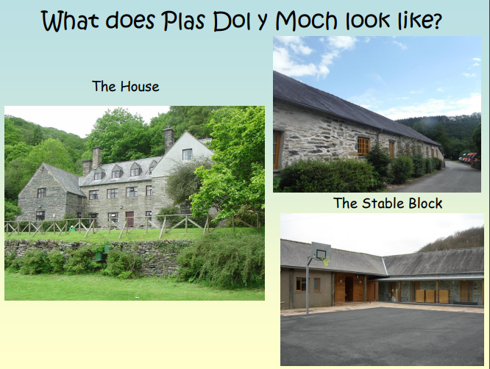

Slide 14
What will Dol-y-moch provide?
Dol-y-Moch will provide all technical and safety kit/equipment for all activities undertaken (e.g. helmets, harness, wetsuit etc). Participants will also be provided with a:
- set of waterproofs (tops & bottoms)
- warm fleece
- windproof
- rucksack
- water-bottle
- wellies/boots

Slide 15
How do the children get to Dol-y-Moch?
Departure - Children are collected by coach at 2pm.
Stop - at Telford Services (snack and toilet break)
Arrival – approximately 6:30pm
Dates: Friday 21st May to Monday 24th May 2027

Slide 16
What happens on arrival?
Welcome/induction by Martin, the course director
Aims/Objectives
Rules/Expectations
Meal
Settle into rooms (children make own beds!)
Get kitted out
Fire Drill

Slide 17
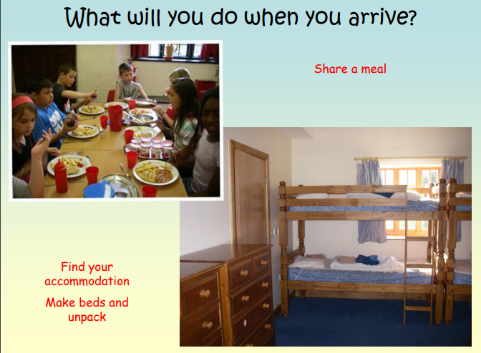

Slide 18
The Three Rs
Resilience through genuine outdoor adventure activities in the great outdoors every day.
Responsibility; through taking care of the Centre (such as keeping beds and dormitories tidy!), any equipment issued to course members, listening and following instructions.
Respect; by looking after each other, and spending plenty of time outside in the wonderful Snowdonia National Park.

Slide 19
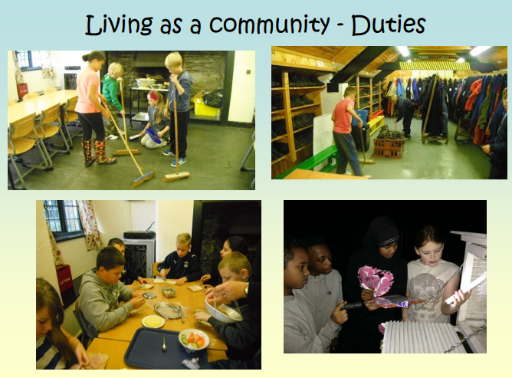

Slide 20
Departure
Friday 17th May 2027
Final tidy up and pack
Breakfast
Dorm inspection
Last meeting
Coach leaves for Solihull at 9am
ETA 1pm approx.

Slide 21
What is the cost of the residential?
£ 309 – includes transport, accommodation, food and all activities
Payment extended to 25th October
Spending money – no more than £15
We appreciate the financial challenges faced by families. Please contact Mrs Lloyd, our Family Support Worker, who will be able to advise you.

Slide 22
Medication
Please collect and complete a medication form from school office if your child will need medication (or may require medication) while they are aware; this includes travel sickness medication. Please hand in medication to your child’s class teacher before departure.
If your child has regular prescribed medication, please arrange a meeting with your child’s class teacher prior to the residential taking place.
Children who have reliever inhalers should keep these on them and not hand them in to a member of staff.

Slide 23
Photo/Filming Consent
During your son/daughter’s course Dol-y-Moch would like to take photographs and video recordings. If appropriate, they would like to make use of these photos/videos for displays around the Centre, on their (including Coventry Outdoors & Coventry City’s) website, presentations, our social media presence, or other print and digital marketing materials.
Please complete a photo/filming consent form either giving or withdrawing consent.

Slide 24
Any questions

