Slide 1
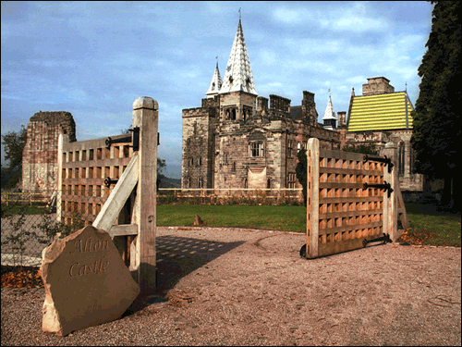
Alton Castle Residential
2027

Slide 2
Objectives for the visit
To enrich the personal, social, religious and spiritual development of Year 5 children
To encourage a deeper awareness of “God in all things”
To increase self-confidence and self-respect by meeting physical challenges and through team work
To begin process of preparation for the Sacrament of Confirmation through experience of the Catholic church beyond the parish of Our Lady of the Wayside

Slide 3
Typical 2 day programme
A selection of :
Nature trekking
Low ropes course
Climbing
Orienteering
Archery
Games
Biking
Survival
Worship

Slide 4
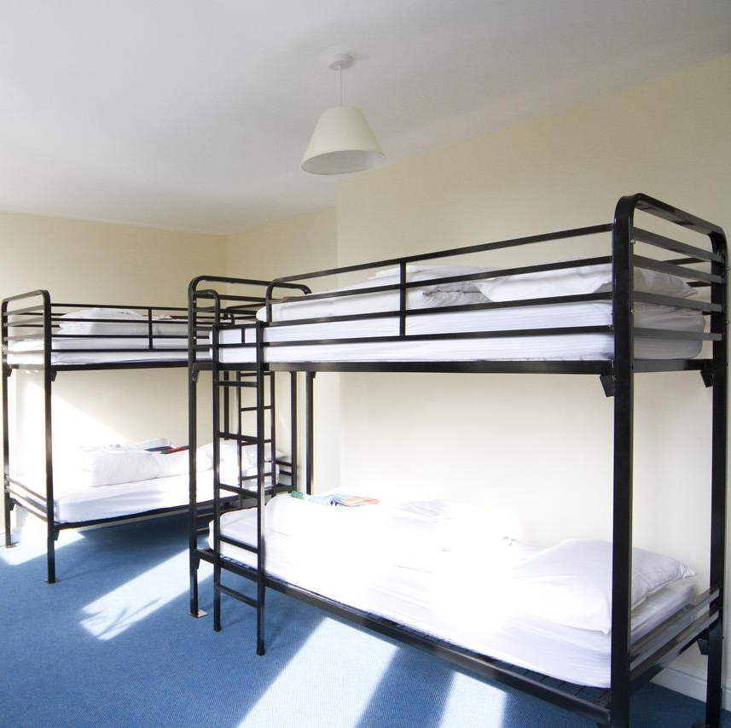
Accommodation
Dormitories
Toilets and shower rooms on corridors
Girls and boys on separate floors
Separate staff bedrooms on same floors
Castle site secured
Fire drill on first evening

Slide 5
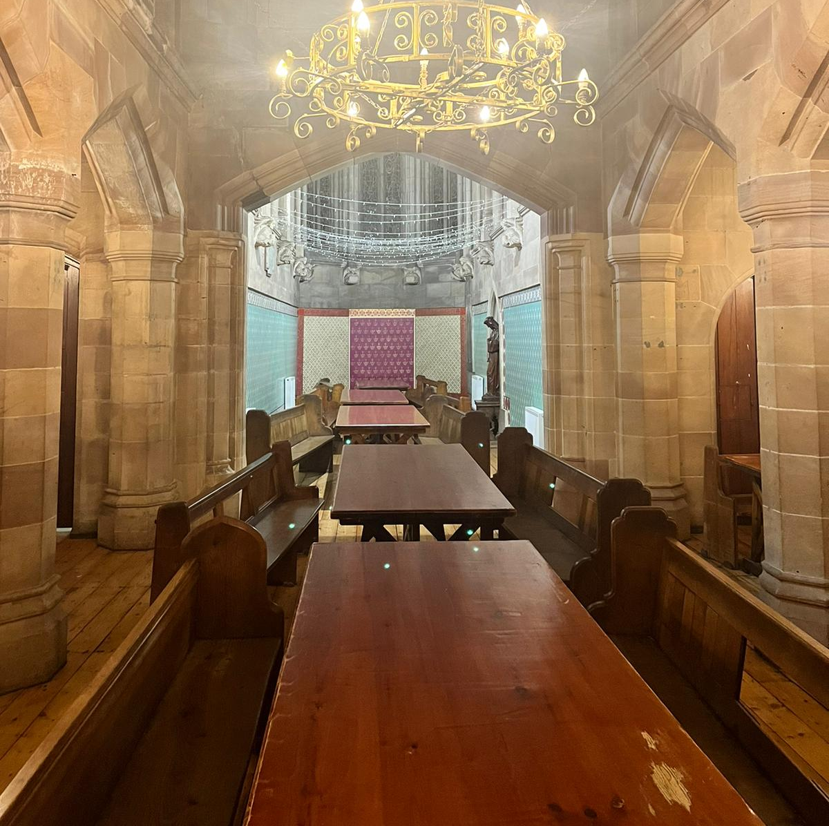
Food
3 main daily meals eaten in the castle refectory.
Volunteers & staff serve meals at table - everyone helps to clear up.
Healthy, hot, nutritious food.
Vegetarian options.
Special dietary needs carefully catered for.
Rationed tuck shop (!)

Slide 6

Health and Safety
The Health and Safety of the groups staying at Alton Castle
is vitally important to all concerned.
Every member of the Alton Castle team is qualified in First Aid At Work and is fully conversant with the Castle's Health and Safety procedures.
There are lifeguards and specialist activity leaders assigned to relevant activities.
Every activity undertaken has had its own risk assessment and safety procedure which groups are expected to adhere to - school will have updated copies of these and forward them to SMBC.
No activities are undertaken that require registration with the Adventure Activities Licensing Authority. However, the same rigorous rules and safety precautions apply to activities which are undertaken on site.
Alton Castle is registered with the H.S.E.

Slide 7

Medical issues
All activities risk assessed, including for asthma, sunburn e.g. inhalers/suncream to be carried.
Parents to complete full medical form before children allowed to participate.
Allergies, special dietary needs taken into account.
Paracetamol, throat lozenges given with consent.
Event of illness/injury - contact parents (details!!!)
Return to school if necessary in non-urgent cases.
First aiders on site - all Alton staff.
No serious accidents since centre opened in 1996.

Slide 8
Staffing
Groups of no more than 15 children for activities with at least one trained member of Alton Castle staff throughout
6 members of staff from school in addition to Alton staff

Slide 9
Kit list
sleeping bag and pillow
indoor and outdoor shoes
an old pair of trainers
Wellingtons* or walking boots* (not essential)
• a warm sweater (fleece jumper if possible)
• suncream & sunhat
• at least 3 complete changes of clothing
plenty of socks
• waterproof jacket
• an inexpensive watch is useful
• toiletries and wash towel
*Don’t buy these specially - Castle loans wellies

Slide 10
PLEASE DO NOT BRING
ANY ITEMS OF VALUE
any items of value such as :
      designer clothes
      Kindle etc
      jewellery
      hand-held computer games
      mobile phones
      items with glass in them
      A small amount of pocket money
      for the tuck shop & souvenir shop
      will be acceptable - £10 max.

Slide 11
Children’s Code of Conduct
Polite, sensible, considerate behaviour essential
Follow all instructions carefully
Treat all personal and Castle owned property with respect
Each child responsible for his/her own property
No eating in dormitories
No chewing gum allowed anywhere on site
Join in as much as possible, but let staff know if there is anything at all which is bothering you
Any child whose behaviour in school before the trip causes serious concern will not go

Slide 12
Dates
Wednesday 24th February - We will be leaving school at 9:15am on Wednesday 24th to arrive at Alton Castle for approximately 11:00am. The coach will collect children from outside Church on the Stratford Road. If you wish to wave goodbye please use the parking facilities at Sainsbury’s or Curry’s and not the school car park.
Please note, children will need a packed lunch for Wednesday. From experience it is best to send lunches in fully disposable packaging as lunchboxes will be smelly if not lost by the time we return.
Friday 26th February - We will be leaving Alton Castle at 2:00pm on Friday and expect to arrive back at school at approximately 3.30pm.

Slide 13
Emergency Contact Details
We work on a policy of ‘no news is good news’, but if there is an emergency at Alton Castle you will be contacted directly using the contact details supplied. We will phone the school office on Wednesday when we have safely arrived at Alton Castle.
In the event of an emergency at home please use the following procedure:
1. During school hours, please contact the school office on 0121 744 6852
2. In out of school hours, staff will contact you via the school mobile.
Please only contact us directly in the case of an emergency.

Slide 15
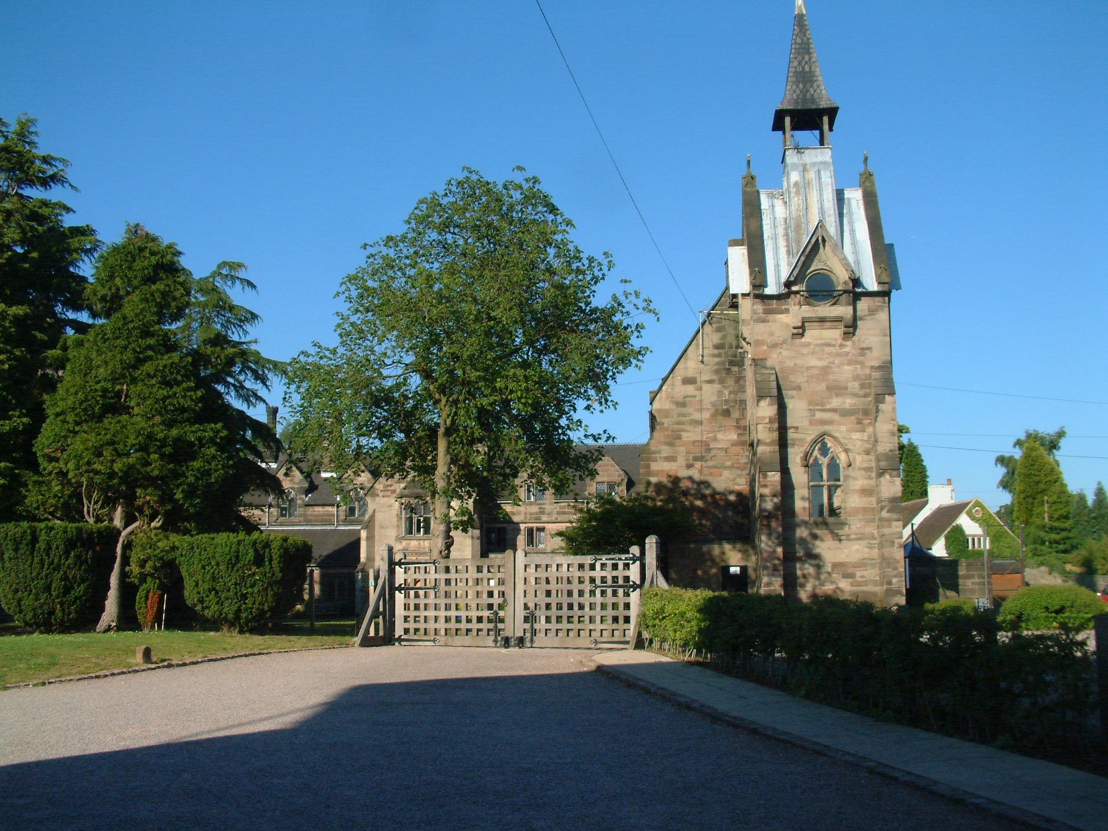

Slide 16


