Slide 1
Parent Information Meeting for Year 5
Welcome to our Parent Information Meeting
Aim
To provide information about what is happening in your child’s year group e.g. the curriculum and enrichment opportunities.
To communicate clearly our expectations about behaviour, uniform, attendance, Pupil Review Meetings, homework and positive relationships.

Slide 2
Catholic Ethos
Everything we do is underpinned by our Catholic ethos
As a Catholic School, we seek to live out the values of Jesus Christ. We promote these values by our words and deeds recognising that every child is unique and is created in the image of God.
Jesus told us to "Love one another as I have loved you" and this reminds us every day to go the extra mile for the children within our care.
Our Lady of the Wayside is a school we are all proud of. Our school is a vibrant, positive place that provides a safe and welcoming environment in which to learn.

Slide 3
Attendance
Good attendance will ensure that your child will have the best chance to achieve their academic potential and have real opportunity in further education and the world of work.
Did you know that…
95% 9 days 2 weeks 50 lessons missed
90% 19 days 4 weeks 100 lessons missed
85% 29 days 6 weeks 150 lessons missed
It may be tempting to book a family holiday in term time to save on costs. However, this has a major impact on learning.

Slide 4
Punctuality
This year, we are having a drive ensure that all children are in school punctually and ready to learn. Regular lateness to school, even by a few minutes, is disruptive to the class and possibly upsetting for your child.
Children should be in school before 8.55am.
Where attendance/punctuality is an issue our school attendance team which includes Mrs Lloyd, Mrs Compton and Mrs Ashcroft, will invite parents/carers into school for short meetings, and to draw up attendance support plans.

Slide 5
 | Autumn Focus
Maths | Number and Place Value Addition and Subtraction Multiplication and Division Fractions
English | Writing to describe Writing to narrate Writing to recount Writing to inform Writing to narrate
RE | Creation and Covenant
Science | Circle of Life (Living Things and their Habitats)

Slide 6
Curriculum Overview
 | Autumn Focus
History | The Round City of Baghdad
RSE | Catholic Social Teaching Who is God calling me to be?
Spanish | TBC
Art and DT PE Computing | Sculpture and 3D: Interactive Installation Textiles - Stuffed Toys Indoor- Dance and Gymnastics Outdoor- Dodgeball and Basketball Online Safety

Slide 7
Presentation of Work
This year at Our Lady of the Wayside, we are on a journey to improve handwriting.
Handwriting is more than just a form of communication; it's a fundamental skill that offers a wide range of benefits for your child's cognitive development. Here are some of the key advantages:
Enhanced Reading and Spelling Skills
Improved Memory and Recall
Increased Motivation to Write
Efficiency in Academic Tasks

Slide 8
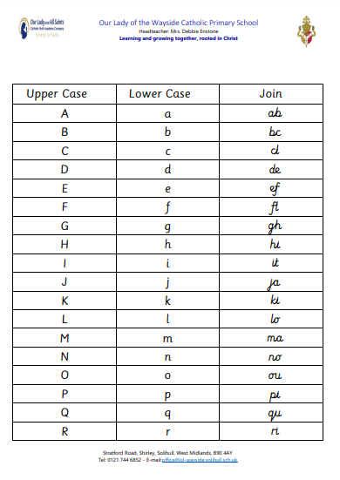
Presentation of Work

Slide 9
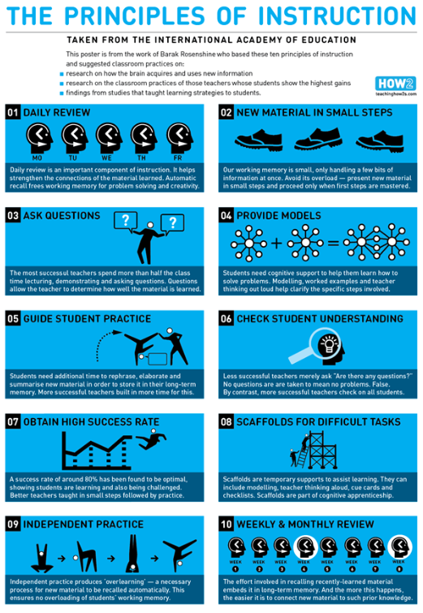

Slide 10
Homework
Our Homework Policy provides clear guidelines about the purpose, expectations and type of homework your child will receive.
We firmly believe that the revised homework policy will contribute positively to your child's educational journey. Please take time to read through the policy which you can find on the school website.
We ask that you encourage your child to complete homework tasks and to contact teachers (or encourage their children to) if their child needs extra support with homework or if the homework is late/incomplete

Slide 11
Homework
Every week, your child will be given a piece of homework.
This will include an English task, a Maths task, a reading task and their spellings and times tables to practise. Please note the spelling rules for that week have already been taught in class so children will just need to practise the spelling words.
Your child will also have a home reader book. This is set to their reading level. The expectation is that your child reads 5 times a week for a minimum of 15 minutes. Included in this, they need to read to an adult at least once a week.
Parents must sign their child’s reading record once a week, minimum. These are checked by your child’s class teacher so are another form of communication.
HOMEWORK IS HANDED IN AND OUT EVERY FRIDAY!

Slide 12
Behaviour
We have high expectations of behaviour. This is set out in our behaviour policy. It can be found on our school website.
Good behaviour is rewarded with:
Whole school House Point reward system (Saint Houses)
Golden Book entry
Golden Book assembly
Golden break time
Marvellous Me message sent home
Stickers/stamps
Personalised reward chart
Visit to another teacher/HT/DHT/AHT for commendation
This year we are really promoting positive learning behaviours and will celebrate your child’s demonstration of these behaviours on Marvellous Me and in Pupil Review Meetings.

Slide 13


Slide 14
Behaviour
Responding to inappropriate behaviour
Staff will respond to inappropriate behaviour predictably, promptly and in a consistent, fair and proportionate manner so that pupils know with certainty that inappropriate behaviour will always be addressed.
At OLW, we have a ‘stepped approach’ for addressing low level behaviours.

Slide 15
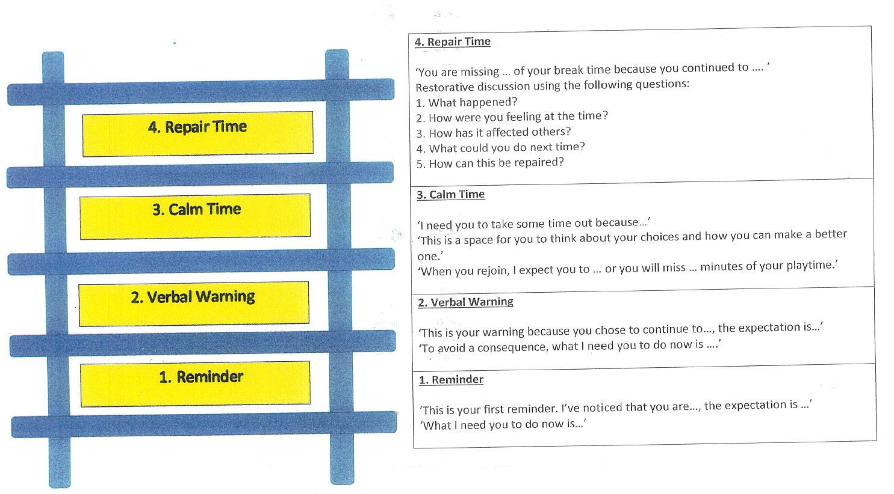

Slide 16
Online Safety
Our first Computing unit this year is Online Safety.
Please speak with your children about strategies to use when using technology, such as playing games online and ensure monitoring of their use.
Social media use age ratings, such as TikTok and Snapchat, are older than our children and can create a risks for children online and in school.

Slide 17
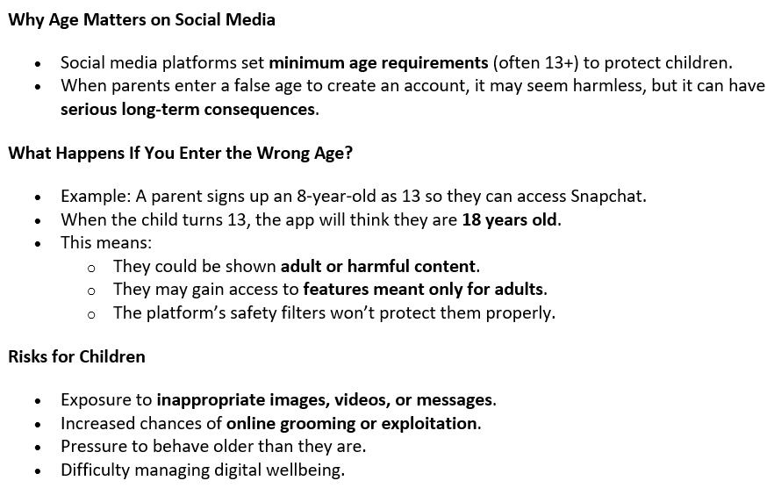
Online Safety
You should have received a parent guide about this. Below are some of the key points:

Slide 18
Uniform
Please ensure that your child wears the correct school uniform and PE uniform
That uniform is labelled
No jewellery please, apart from simple silver/gold studs.
Sensible hair accessories (blue, small hair ties)
PE uniform to be worn on Thursdays (indoor) and Friday (outdoor)

Slide 19
Water bottles
These should contain water, not juice.
Please can we ask that children use smaller water bottles as these fit the water towers (and less expensive!)

Slide 20
Communication
Parentpay
Marvellous Me
- Reminders
If your child is in the Golden Book
Demonstrated a positive learning behaviour
Ask you to ask your child about their learning twice a week
Instagram, our new sharing platform

Slide 21
Sharing and Resolving Concerns
A reminder that we have clear pathways to ensure a concern you may have is quickly and effectively resolved. The pathway is:
Stage 1:
Discuss your concern with your child’s class teacher. They will work with you to discuss and resolve your concern. Please allow sufficient time for this process to be completed.
Stage 2:
Please escalate your concern to your child’s Phase Leader who will consider your concern and review the response given by your child’s class teacher. The Phase Leaders for academic year 2025-2026 are:
Early Phase (Nursery and Reception) Mrs Churchill
Lower Phase (Year 1 and Year 2) Mrs Compton
Middle Phase (Year 3 and Year 4) Miss Yarnold
Upper Phase (Year 5 and Year 6) Mr Craggs

Slide 22
Sharing and Resolving Concerns
Stage 3:
Please escalate your concern to Mrs Compton (Assistant Headteacher and SENCO) if your child is in Early and Lower Phase and Mrs Ashcroft, Deputy Headteacher if your child is in Middle and Upper Phase. Mrs Compton/Mrs Ashcroft will consider your concern and review the responses given by your child’s class teacher and your child’s Phase Leader. Please complete a parent escalation form at this stage available from the class teacher.
Stage 4:
Make a formal complaint following the School’s Complaint Policy (available on our website). Mrs Enstone will consider your complaint and review the responses given by Mrs Compton/Mrs Ashcroft, your child’s Phase Leader and their class teacher.
Please trust us, we will follow procedures but please be respectful of decisions or outcomes.

Slide 23
Parent’s Evening
Autumn – face to face (Wednesday 21st and Thursday 22nd October)
Spring – face to face TBC
Summer – report with opportunity to discuss face to face.

Slide 24
SEND
Mrs Compton is our SENCO.
Please do make an appointment with her and your child’s class teacher if you feel your child has an underlying need or if you are concerned about behaviours at home.

Slide 25
Safeguarding
At Our Lady of the Wayside we recognise our moral and statutory responsibility to safeguard and promote the welfare of all pupils. We endeavour to provide a safe and welcoming environment where children are respected and valued. We are alert to the signs of abuse and neglect and follow our procedures to ensure that children receive effective support, protection and justice. Safeguarding our children is the responsibility of every member of staff at OLW.
Our Lady of the Wayside has policies in place for Safeguarding, Child Protection & Behaviour which are read and adhered to by all staff. Visitors, supply teachers etc. must familiarise themselves with the school’s requirements regarding child protection, safeguarding and behavioural expectations.

Slide 26
Safeguarding
We have a dedicated safeguarding team who work together to ensure the safety of all children at OLW.
The school has five named DSL’s (Designated Safeguarding Leads) for Child Protection:
Mrs Enstone (Headteacher), Mrs Ashcroft (Deputy Headteacher), Mr Craggs (Assisstant Headteacher, Upper Phase Lead and Y6 Teacher) and Mrs Compton (SENCO, Assisstant Headteacher and Y1 Teacher) and Mrs Lloyd (Family Support Manager).
If your child sustains an injury such as a bruise, please inform us about how this has happened as we will be required to investigate as part of our safeguarding procedures.

Slide 27
Enrichment Opportunities
In year 5, we go to...
Alton Castle (Wednesday 24th - Friday 26th February)
St James Easter journey trip.
Bikeability
Farm trip (geography link)
Pantomime
Sport’s Day at Norman Green

Slide 28
Pupil Premium
If your child is eligible for ‘free school meals’ and you register them for this, we’ll receive extra funding called ‘pupil premium’. We use this extra money to improve the educational provision and resources at the school.
If you want to find out if your child is eligible for this and how to apply, please see Mrs Chambers in the school office.

Slide 29
Questions
Thank you for attending the Parent Information Meeting for Year 5
We are available after for any individual questions

