Slide 1
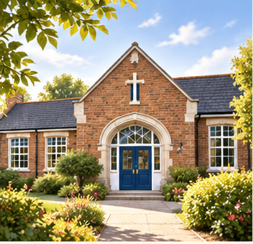
Parent Information Meeting for Y4
Welcome to our Parent Information Meeting
Aim
To provide information about what is happening in your child’s year group.
To communicate clearly our expectations about behaviour, uniform, attendance, Pupil Review Meetings, homework and positive relationships.
Notes:
[Sources]
- Visual: original illustration generated for this presentation; no external source.
- Slide text retained from the supplied parent information meeting deck.

Slide 2

Catholic Ethos
Everything we do is underpinned by our Catholic ethos
As a Catholic School, we seek to live out the values of Jesus Christ. We promote these values by our words and deeds recognising that every child is unique and is created in the image of God.
Jesus told us to "Love one another as I have loved you" and this reminds us every day to go the extra mile for the children within our care.
Our Lady of the Wayside is a school we are all proud of. Our school is a vibrant, positive place that provides a safe and welcoming environment in which to learn.
Notes:
[Sources]
- Visual: original illustration generated for this presentation; no external source.
- Slide text retained from the supplied parent information meeting deck.

Slide 3

Attendance
Good attendance will ensure that your child will have the best chance to achieve their academic potential and have real opportunity in further education and the world of work.
Did you know that…
95% 9 days 2 weeks 50 lessons missed
90% 19 days 4 weeks 100 lessons missed
85% 29 days 6 weeks 150 lessons missed
It may be tempting to book a family holiday in term time to save on costs. However, this has a major impact on learning.
Notes:
[Sources]
- Visual: original illustration generated for this presentation; no external source.
- Slide text retained from the supplied parent information meeting deck.

Slide 4

Punctuality
This year, we are having a drive ensure that all children are in school punctually and ready to learn. Regular lateness to school, even by a few minutes, is disruptive to the class and possibly upsetting for your child.
Children should be in school before 8.55am. Lateness after 9.05am will be recorded as unauthorised.
Breakfast Club – Children can have breakfast 8.30 till 8.45.
Notes:
[Sources]
- Visual: original illustration generated for this presentation; no external source.
- Slide text retained from the supplied parent information meeting deck.

Slide 5

Presentation of Work
This year at Our Lady of the Wayside, we are on a journey to improve handwriting.
Handwriting is more than just a form of communication; it's a fundamental skill that offers a wide range of benefits for your child's cognitive development. Here are some of the key advantages:
Enhanced Reading and Spelling Skills
Improved Memory and Recall
Increased Motivation to Write
Efficiency in Academic Tasks
.
Notes:
[Sources]
- Visual: original illustration generated for this presentation; no external source.
- Slide text retained from the supplied parent information meeting deck.

Slide 6
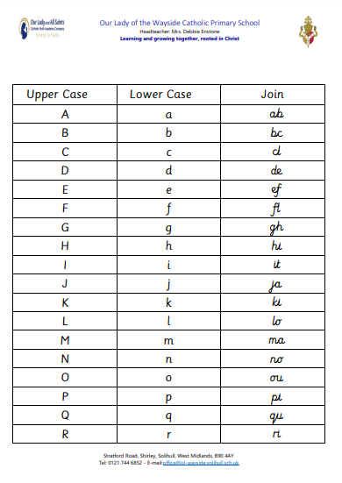
Presentation of Work

Slide 7
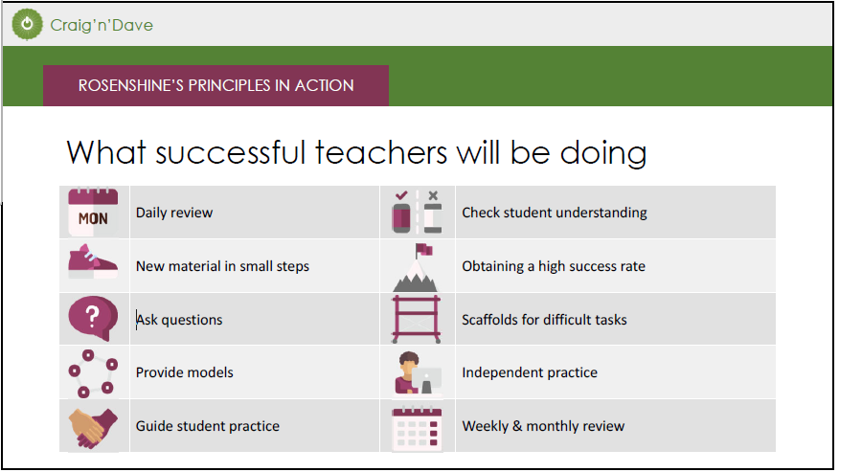
Rosenshines Principles of Learning

Slide 8

Homework
The Homework Policy which provides clear guidelines about the purpose, expectations and type of homework your child will receive.
We firmly believe that the homework policy will contribute positively to your child's educational journey. Please take time to read through the policy which you can find on the school website.
We ask that you encourage your child to complete homework tasks and to contact teachers (or encourage their children to) if their child needs extra support with homework or if the homework is late/incomplete.
Homework goes out on a Friday and to be returned the following Friday. Homework mostly consists of spellings, Maths and English. This is not new learning but consolidation of what they children have already done. Children will also take home a reading book which is to be read over 1-2 weeks depending on its length. It in important that children are heard read at home every week and the reading record is filled in weekly by the parent/ guardian.
Notes:
[Sources]
- Visual: original illustration generated for this presentation; no external source.
- Slide text retained from the supplied parent information meeting deck.

Slide 9

Behaviour
We have high expectations of behaviour. This is set out in our behaviour policy. It can be found on our school website.
Good behaviour is rewarded with:
Whole school House Point reward system (Saint Houses)
Golden Book entry
Golden Book assembly
Golden break time
Marvellous Me message sent home
Stickers/stamps
Personalised reward chart
Visit to another teacher/HT/DHT/AHT for commendation
Timetables Rockstars trophy and certificates
This year we are really promoting positive learning behaviours and will celebrate your child’s demonstration of these behaviours on Marvellous Me and in Pupil Review Meetings.
Notes:
[Sources]
- Visual: original illustration generated for this presentation; no external source.
- Slide text retained from the supplied parent information meeting deck.

Slide 10
Behaviour
Responding to inappropriate behaviour
Staff will respond to inappropriate behaviour predictably, promptly and in a consistent, fair and proportionate manner so that pupils know with certainty that inappropriate behaviour will always be addressed.
At OLW, we have a ‘stepped approach’ for addressing low level behaviours.
Step 1 - 1st Reminder
A child is told that their behaviour is inappropriate (label behaviour) and the impact that it is having on others. They will be offered a chance to change their behaviour and make a good choice.
Step 2 – 2nd verbal warning
The child is reminded that their behaviour (label behaviour) is still inappropriate and how it is impacting on others. They will be given another chance to change their behaviour and make a good choice.
Step 3 – Calm Time
If a pupil’s behaviour requires further support, they will be given a short period of time away from their classroom in a partner class or another appropriate space. This time is intended to provide the pupil with an opportunity to regulate their emotions, calm down and reflect on their behaviour in a supportive environment.
The incident will be recorded on CPOMS and parents/carers will be informed where appropriate. Following the incident, staff will use the STAR approach (Setting, Trigger, Action, Result) to identify any patterns, triggers or antecedents that may have contributed to the behaviour. This information will help staff to better understand the pupil’s needs and put appropriate strategies and support in place to promote positive behaviour

Slide 11
Behaviour
Step 4 – Repair
A discussion using restorative language takes place at break time with the pupil.
1.What happened?
2.How were you feeling at the time?
3.How has it affected others?
4.What could you do next time?
5.How can this be repaired?
The repair will include a reflection period, as outlined below. This will be communicated to parents by the class teacher.

Slide 12
Behaviour
The following consequences apply where the same or similar inappropriate behaviour is repeated.
· First instance: The pupil will have a 5-minute reflection period during break time. An informal conversation will take place with parents/carers to discuss the incident and ensure they are aware of the behaviour.
· Second instance: The pupil will have a 15-minute reflection period during lunchtime. Parents/carers will be spoken to and reminded of the next steps should the behaviour continue.
· Third instance: The pupil will have a 15-minute reflection period during lunchtime. A formal meeting will be arranged with the parent/carer and pupil to discuss the behaviour, identify any underlying needs and agree on appropriate support and next steps.
4.What could you do next time?
5.How can this be repaired?
The repair will include a reflection period, as outlined below. This will be communicated to parents by the class teacher.

Slide 13
Serious Incident
For more serious behaviours, including violence, physical aggression, defiance, or persistent low-level disruption, the class teacher will carry out an investigation with the pupil(s) involved. This will include gathering information about the context, circumstances and intent behind the behaviour. Staff will then determine an appropriate and proportionate response, taking into account the individual needs and circumstances of the pupil.
The incident will be referred to a member of SLT, such as the Phase Leader, Deputy Headteacher, or Headteacher. The behaviour incident will be recorded on CPOMS and a meeting will be arranged with parents/carers to discuss the incident, the support required, and the next steps.
Possible consequences and next steps:
· First instance: The pupil will complete a 30-minute reflection period during lunchtime.
· Second instance: The pupil will complete an in-school exclusion and will be placed on a behaviour journal for two weeks to monitor the specific behaviour. If the behaviour occurs again during this monitoring period, the pupil will move immediately to a report card system, including weekly meetings with parents/carers to review progress and identify further support strategies.
· Third instance: The pupil will be placed on a report card with regular monitoring and weekly meetings with parents/carers. A personalised behaviour support plan may also be considered, involving relevant staff and external agencies where appropriate.

Slide 14

Uniform
Please ensure that your child wears the correct school uniform and PE uniform
That uniform is labelled
No jewellery please, except stud earrings.
PLEASE REMOVE EARRINGS FOR SWIMMING DAY!
No nail varnish
For PE, they are allowed to wear dark, plain bottoms with the school PE top and school jumper.
Long hair to be tied up on PE days.
Notes:
[Sources]
- Visual: original illustration generated for this presentation; no external source.
- Slide text retained from the supplied parent information meeting deck.

Slide 15

Communication
Parentpay
Marvellous Me
- Reminders
If your child is in the Golden Book
Demonstrated a positive learning behaviour
Ask you to ask your child about their learning twice a week
Instagram (IF NOT SO ALREADY PLEASE LET THE OFFICE KNOW IF YOUR CHILD CAN BE ON INSTAGRAM)
Notes:
[Sources]
- Visual: original illustration generated for this presentation; no external source.
- Slide text retained from the supplied parent information meeting deck.

Slide 16
Sharing and Resolving Concerns
A reminder that we have clear pathways to ensure a concern you may have is quickly and effectively resolved.
Please speak to your child’s class teacher first and they can escalate it further if needed.
In any incident, you don’t feel as though your issue has been resolved, you may speak to Miss Yarnold (middle phase lead).

Slide 17

SEND
Mrs Compton is our SENCO.
Please do make an appointment with her and your child’s class teacher if you feel your child has an underlying need or if you are concerned about behaviours at home.
Notes:
[Sources]
- Visual: original illustration generated for this presentation; no external source.
- Slide text retained from the supplied parent information meeting deck.

Slide 18

Safeguarding
We have a dedicated safeguarding team who work together to ensure the safety of all children at OLW.
The school has four named DSL’s (Designated Safeguarding Leads) for Child Protection:
Mrs Enstone (Headteacher), Mrs Ashcroft (Deputy Headteacher), Mrs Compton (Assistant Head/Y1 Teacher/SENCO) and Mrs Lloyd (Family Support Manager). Mr Craggs (Year 6 teacher and Assistant Head)
If your child sustains an injury such as a bruise, please inform us about how this has happened as we will be required to investigate as part of our safeguarding procedures.
Notes:
[Sources]
- Visual: original illustration generated for this presentation; no external source.
- Slide text retained from the supplied parent information meeting deck.

Slide 19
Enrichment Opportunities
Lickey Hills (Geography links)
Cricket Festival (Games)
PGL (Residential) Borreaton Park
Swimming (National curriculum requirement.)
Pantomime

Slide 20
Statutory Assessments
Times Table Check
What = determine whether your child can fluently recall their times tables up to 12
How = On-screen check of 25 questions. They have 6 seconds to answer each question. (Maths Frame)
(‘Try it out’ before the summer term to help children!)

Slide 21
Pupil Premium
If your child is eligible for ‘free school meals’ and you register them for this, we’ll receive extra funding called ‘pupil premium’. We use this extra money to improve the educational provision and resources at the school.
If you want to find out if your child is eligible for this and how to apply, please see Mrs Chambers in the school office.

Slide 22
Parent Guide: Social Media Ages & Online Safety
We are seeing an increasing risk of social media issues amongst children in year 4.
Parents should be mindful when creating social media accounts for their children using an incorrect date of birth. For example, if a parent registers an 8-year-old as 13 in order to access a platform like Snapchat, by the time the child actually turns 13, the app will assume they are 18. This can expose the child to content, features, and interactions intended only for adults, including inappropriate or harmful material.
Accurate age settings are critical to ensure children are protected online and only access content that is age-appropriate.
Why Age Matters on Social Media
Social media platforms set minimum age requirements (often 13+) to protect children.
When parents enter a false age to create an account, it may seem harmless, but it can have serious long-term consequences.
What Happens If You Enter the Wrong Age?
Example: A parent signs up an 8-year-old as 13 so they can access Snapchat.
When the child turns 13, the app will think they are 18 years old.
This means:
  They could be shown adult or harmful content.
  They may gain access to features meant only for adults.
  The platform’s safety filters won’t protect them properly.

Slide 23
Risks for Children
Exposure to inappropriate images, videos, or messages.
Increased chances of online grooming or exploitation.
Pressure to behave older than they are.
Difficulty managing digital wellbeing.
Safer Alternatives
✅ Wait until your child is the appropriate age before opening accounts.
✅ Use child-friendly apps and platforms designed for younger users.
✅ Set up parental controls and privacy settings on devices.
✅ Talk openly with your child about online safety, peer pressure, and boundaries.
✅ Regularly check in on their digital activity in a supportive way.
Key Takeaway
Always use your child’s real age when creating accounts. It helps platforms provide the right level of protection and ensures children only access content that is safe and appropriate.

Slide 24

Parent Partnership
We have summarised our expectations into a document. Please can you familiarise yourself with it. It outlines not just expectations for parents but for pupils and teachers also.
Notes:
[Sources]
- Visual: original illustration generated for this presentation; no external source.
- Slide text retained from the supplied parent information meeting deck.

Slide 25
Questions
Thank you for attending the Parent Information Meeting for Y4

