Slide 1
Parent Information Meeting for Y2
Welcome to our Parent Information Meeting
We will provide information about what is happening in your child’s year group
We will communicate our expectations about behaviour, uniform, attendance, Pupil Review Meetings, homework and positive relationships.

Slide 2
Catholic Ethos
Everything we do is underpinned by our Catholic ethos
As a Catholic School, we seek to live out the values of Jesus Christ.
We promote these values by our words and deeds recognising that every child is unique and is created in the image of God.
Jesus told us to "Love one another as I have loved you" and this reminds us every day to go the extra mile for the children within our care.
Our Lady of the Wayside is a school we are all proud of. Our school is a vibrant, positive place that provides a safe and welcoming environment in which to learn.

Slide 3
Attendance
Good attendance will ensure that your child will have the best chance to achieve their academic potential and have real opportunity in further education and the world of work.
Did you know that…
95% 9 days 2 weeks 50 lessons missed
90% 19 days 4 weeks 100 lessons missed
85% 29 days 6 weeks 150 lessons missed
It may be tempting to book a family holiday in term time to save on costs. However, this has a major impact on learning.

Slide 4
Punctuality
We must ensure that all children are in school punctually and ready to learn.
Regular lateness to school, even by a few minutes, is disruptive to the class and sometimes upsetting for your child.
Children should be in school before 8.55am. Lateness after 9.05am will be recorded as unauthorised.
Where attendance/punctuality is an issue our school attendance team which includes Mrs Lloyd and Mrs Ashcroft, will invite parents/carers into school for short meetings, and to draw up attendance support plans.

Slide 5
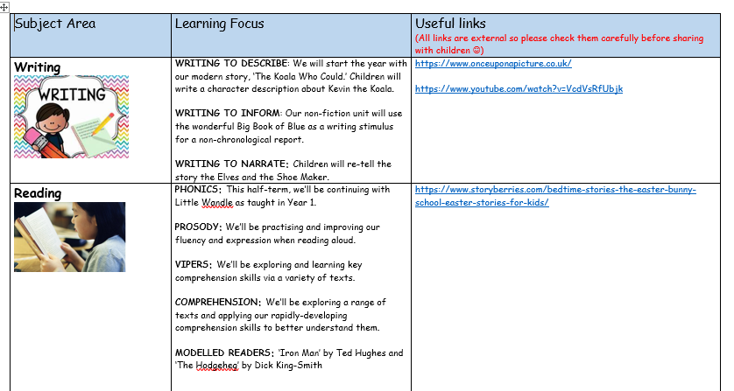
Curriculum Overview

Slide 6
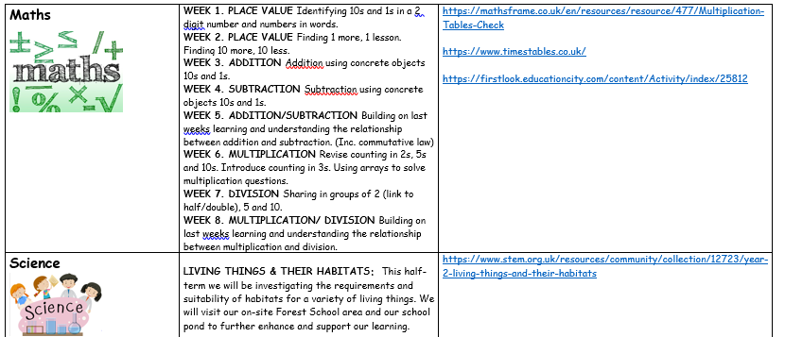

New RE Curriculum

Slide 7
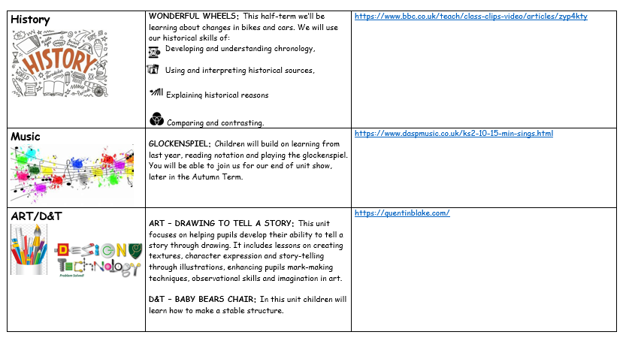

Slide 8
Rosenshine’s Priciples
At our school, we aim to give every child the best chance to succeed by using teaching strategies that are proven to work. One approach we follow is based on Rosenshine’s Principles of Instruction – a set of research-based ideas that help children learn more effectively. Here’s how we use these principles in our Year 2 classrooms:
Daily Review -We begin each day by reviewing key learning from previous lessons. This might be a quick quiz, a discussion, or a few practice questions. It helps children remember what they’ve learned and builds strong foundations before we introduce new content.
Presenting New Material in Small Steps -Rather than giving too much information at once, we break lessons into small, manageable chunks. This way, children are not overwhelmed and have time to fully understand each part before moving on.
Asking Lots of Questions- We ask questions throughout the lesson – to check understanding, get children thinking, and keep them engaged. This also helps us spot who might need extra help.
Providing Clear Models - When we teach new skills (like how to solve a maths problem or write a sentence), we show clear examples. We model the process step by step so children know exactly what success looks like.
Guided Practice - Children don’t do everything on their own straight away. First, we practise together, giving them support and guidance as they learn new things.
Checking for Understanding - We regularly check how well children are understanding what we’re teaching. If something isn’t clear, we’ll go over it again in a different way.
We aim for a high success rate by giving children work that’s challenging but achievable. With support and guided practice, they build confidence and stay motivated by experiencing regular success.
Providing Scaffolds for Difficult Tasks - We give extra support when children are tackling more challenging work – such as sentence starters, word banks, or guided prompts – and gradually remove that support as their confidence grows.
Independent Practice - Once children have had enough support and practice, they work independently to apply what they've learned. This helps secure their understanding and builds confidence.
Reviewing Learning Regularly - We return to key ideas over time to help children remember them long-term – whether it’s phonics, times tables, or grammar rules
By using Rosenshine’s principles, we help your child feel more confident, secure, and successful in their learning. It’s all about building knowledge step by step, with lots of support along the way

Slide 9
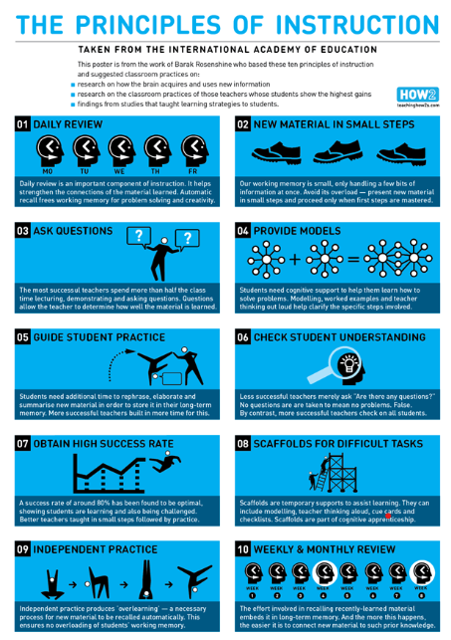

Slide 10
Presentation of Work
This year at Our Lady of the Wayside, we continue our journey to improve handwriting.
Handwriting is more than just a form of communication; it's a fundamental skill that offers a wide range of benefits for your child's cognitive development. Here are some of the key advantages:
Enhanced Reading and Spelling Skills
Improved Memory and Recall
Increased Motivation to Write
Efficiency in Academic Tasks

Slide 11
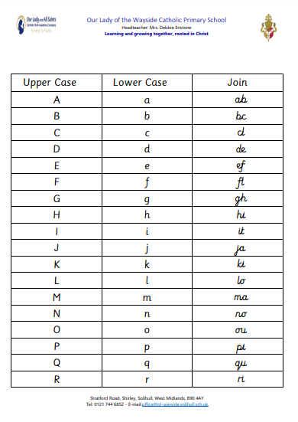
Presentation of Work

Slide 12
Homework
We have a Homework Policy which provides clear guidelines about the purpose, expectations and type of homework your child will receive.
We firmly believe that the homework policy will contribute positively to your child's educational journey. Please take time to read through the policy which you can find on the school website.
We ask that you encourage your child to complete homework tasks and to contact teachers (or encourage their children to) if their child needs extra support with homework or if the homework is late/incomplete.

Slide 13
Homework
Homework is sent home every Wednesday.
It comprises of…
A ‘phonics recap’ – children revisit the graphemes, and their supporting words, and the ‘tricky words’ we have met throughout the week.
A writing exercise, to support and offer practise to develop a skill we have been learning.
A maths activity to further support, enhance and consolidate all that we have been learning in maths.
Homework packs should be returned EVERY MONDAY MORNING so that we are able to assess the previous week’s homework and issue the next.

Slide 14
Behaviour
We have high expectations of behaviour. This is set out in our behaviour policy. It can be found on our school website.
Good behaviour is rewarded with:
Whole school House Point reward system (Saint Houses)
Golden Book assembly
Golden break time
Marvellous Me message sent home
Stickers/stamps
Personalised reward chart
Visit to another teacher/HT/DHT/AHT for commendation
We always pomote positive learning behaviours and will celebrate your child’s demonstration of these behaviours on Marvellous Me and in Parents Evenings.

Slide 15
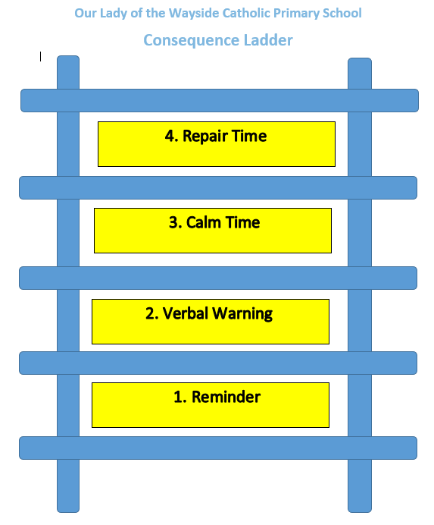
Behaviour
Responding to inappropriate behaviour
Staff will respond to inappropriate behaviour predictably, promptly and in a consistent, fair and proportionate manner so that pupils know with certainty that inappropriate behaviour will always be addressed.
At OLW, we have a ‘stepped approach’ for addressing low level behaviours.
Step 1 - 1st Reminder (first verbal warming)
A child is told that their behaviour is inappropriate (label behaviour) and the impact that it is having on others. They will be offered a chance to change their behaviour and make a good choice.
Step 2 – 2nd verbal warning
The child is reminded that their behaviour (label behaviour) is still inappropriate and how it is impacting on others. They will be given another chance to change their behaviour and make a good choice.
Step 3 – Time out in the classroom
The child is told that they have been spoken to twice about their inappropriate behaviour (label behaviour) and that they will have some time out in the classroom to help them change and reflect on their behaviour.

Slide 16
Behaviour
Responding to inappropriate behaviour
Step 3 – Calm Time Time out in the classroom
The child is told that they have been spoken to twice about their inappropriate behaviour (label behaviour) and that they will spend time in another class for a period of no more than 5 minutes. This time away from the classroom environment is once again to help them change and reflect on their behaviour.
Step 4 – Repair Time
Children will be given time to reflect on their behaviour.
Reoccuring incidents – Loss of some lunchtime break
Children missing part of lunchtime break will be supervised in a classroom.
This stepped approach is clearly visible as a Consequence Ladder poster displayed in each classroom. At each stage, staff will try to identify the reasons for a behaviour and help a child to reflect and change their behaviours.

Slide 17
Uniform
Please ensure:
Your child wears the correct school uniform and PE uniform
That ALL uniform is clearly labelled with your child’s name and class
No jewellery is worn; earrings should be studs, not hoops
Shirts are tucked in

Slide 18
Water bottles
These should contain water, not juice.
Please can we ask that children use smaller water bottles as these fit the water towers (and are less expensive!)

Slide 19
Communication
ParentPay
Marvellous Me
- Reminders
    If your child is in the Golden Book
    Demonstrated a positive learning behaviour
    Ask you to ask your child about their learning during the week
Instagram

Slide 20
Communication
WhatsApp Groups
It can be very useful for parents to communicate with each other via WhatsApp (reminders for non-uniform day etc).
However, if you have any concerns please come to school and don’t air them in WhatsApp groups so they can be dealt with fairly, appropriately and effectively for all concerned.

Slide 21
Sharing and Resolving Concerns
A reminder that we have clear pathways to ensure a concern you may have is quickly and effectively resolved. The pathway is:
Stage 1:
Discuss your concern with your child’s class teacher. They will work with you to discuss and resolve your concern. Please allow sufficient time for this process to be completed.
Stage 2:
Please escalate your concern to your child’s Phase Leader who will consider your concern and review the response given by your child’s class teacher. The Phase Leaders for academic year 2024-2025 are:
Early Phase (Nursery and Reception) Mrs Ashcroft
Lower Phase (Year 1 and Year 2) Mrs Compton
Middle Phase (Year 3 and Year 4) Miss Yarnold
Upper Phase (Year 5 and Year 6) Mr Craggs

Slide 22
Sharing and Resolving Concerns
Stage 3:
Please escalate your concern to Mrs Compton (Lower Phase Leader) Mrs Ashcroft will consider your concern and review the responses given by your child’s class teacher and your child’s Phase Leader. Please complete a parent escalation form at this stage available from the class teacher.
Stage 4:
Make a formal complaint following the School’s Complaint Policy (available on our website). Mrs Enstone will consider your complaint and review the responses given by Mrs Ashcroft, your child’s Phase Leader and their class teacher.
Please trust us, we will follow procedures but please be respectful of decisions or outcomes.

Slide 23
Pupil Review Targets
Your child will receive a pupil report targets during the academic year
You will be invited to attend Parent’s Evening where your child’s pupil report targets will be discussed and new targets set then reviewed.
Pupils are welcome to attend the meeting as the child is at the heart of the process.

Slide 24
SEND
Mrs Compton is our SENCO.
In the first instance, please make an appointment with us as your child’s class teacher if you feel your child has an underlying need or if you are concerned about behaviours at home.
Then we can inform Mrs Compton before arranging meetings with yourselves or any other external agencies.

Slide 25
Safeguarding
At Our Lady of the Wayside we recognise our moral and statutory responsibility to safeguard and promote the welfare of all pupils. We endeavour to provide a safe and welcoming environment where children are respected and valued. We are alert to the signs of abuse and neglect and follow our procedures to ensure that children receive effective support, protection and justice. Safeguarding our children is the responsibility of every member of staff at OLW.
Our Lady of the Wayside has policies in place for Safeguarding, Child Protection & Behaviour which are read and adhered to by all staff. Visitors, supply teachers etc. must familiarise themselves with the school’s requirements regarding child protection, safeguarding and behavioural expectations.

Slide 26
Safeguarding
We have a dedicated safeguarding team who work together to ensure the safety of all children at OLW.
The school has five named DSL’s (Designated Safeguarding Leads) for Child Protection:
Mrs Enstone (Headteacher), Mrs Ashcroft (Deputy Headteacher), Mrs Compton (Assistant Headteacher/SENCO/ Early Phase Lead), Mr Craggs (Assistant Headteacher) and Mrs Lloyd (Family Support Manager).
If your child sustains an injury such as a bruise, please inform us about how this has happened as we will be required to investigate as part of our safeguarding procedures.

Slide 27
Parent Guide: Social Media Ages & Online Safety
Parents should be mindful when creating social media accounts for their children using an incorrect date of birth. For example, if a parent registers an 8-year-old as 13 in order to access a platform like Snapchat, by the time the child actually turns 13, the app will assume they are 18. This can expose the child to content, features, and interactions intended only for adults, including inappropriate or harmful material.
Accurate age settings are critical to ensure children are protected online and only access content that is age-appropriate.
Why Age Matters on Social Media
• Social media platforms set minimum age requirements (often 13+) to protect children.
• When parents enter a false age to create an account, it may seem harmless, but it can have serious long-term consequences.
What Happens If You Enter the Wrong Age?
• Example: A parent signs up an 8-year-old as 13 so they can access Snapchat.
• When the child turns 13, the app will think they are 18 years old.
• This means:
o They could be shown adult or harmful content.
o They may gain access to features meant only for adults.
o The platform’s safety filters won’t protect them properly.
Risks for Children
• Exposure to inappropriate images, videos, or messages.
• Increased chances of online grooming or exploitation.
• Pressure to behave older than they are.
• Difficulty managing digital wellbeing.
Safer Alternatives
✅ Wait until your child is the appropriate age before opening accounts.
✅ Use child-friendly apps and platforms designed for younger users.
✅ Set up parental controls and privacy settings on devices.
✅ Talk openly with your child about online safety, peer pressure, and boundaries.
✅ Regularly check in on their digital activity in a supportive way.
Key Takeaway
Always use your child’s real age when creating accounts. It helps platforms provide the right level of protection and ensures children only access content that is safe and appropriate.

Slide 28
Enrichment Opportunities
There are many enrichment opportunities planned for Year 2.
The children will soon be taking part in weekly glockenspiel lessons.
In December, we will be offered the opportunity to attend a Pantomime (Oh yes, we are!).
As part of our learning about cities in Geography, we will visit Birmingham and Lego Discovery, exploring a Lego model of the city.
To support our learning about animals and their habitats, we will be visiting the Habitat Survival Trust.
To enhance our learning about other religions, we have been invited to visit Redditch Mosque for a guided tour.
The children also visit Bourneville and Cadbury World to support our topic Bourneville in Geography.

Slide 29
Statutory Assessments
A few children may need to retake the phonics screening test.
KS1 SATs are non-statutory but we use them as another assessment tool to support teacher judgements.

Slide 30
Pupil Premium
If your child is eligible for ‘free school meals’ and you register them for this, we’ll receive extra funding called ‘pupil premium’. We use this extra money to improve the educational provision and resources at the school.
If you want to find out if your child is eligible for this and how to apply, please see Mrs Chambers in the school office.

Slide 31
Parent Partnership
We have summarised our expectations into a document. Please can you familiarise yourself with it. It outlines not just expectations for parents but for pupils and teachers also.

Slide 32
Questions
Thank you for attending the Parent Information Meeting for Y2
We are available afterwards for any individual questions

