Slide 1
Our Lady of the Wayside Catholic Primary School
Teaching for Mastery

Slide 2
Professional Learning Outcomes
Our professional learning outcomes were:
Sharing learning from the sessions with all class teachers to include:
  Oracy Focus (NCETM)
  Variation
  Maths guidance KS1 and KS2 document for each year group (DfE 2020) – advised teacher to use this to support planning.
  Curriculum prioritisation documents (weblink)
  Ready to progress criteria shared as assessment tool alongside NFER testing
We are instilling in all our teachers, ‘keep up, not catch up!’
Regular maths CPD for all staff is required next year. We wish to further develop an effective collaborative planning culture which shares ongoing specialist subject knowledge. Access to this CPD is for all teachers to uphold the cycle of improvement.

Slide 3
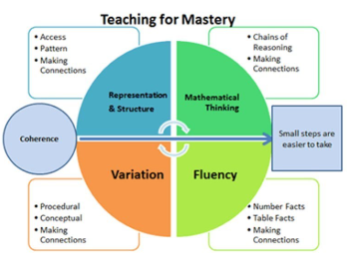
Practice Development Outcomes
Our practice development outcomes were:
I have directed colleagues to the NCETM material to support their planning.
We intend to model mastery teaching in the Autumn term (2026) with teachers observing colleagues with effective delivery.
We intend holding three CPD sessions with staff to reflect collaboratively on subject knowledge to provide a coherent mastery curriculum.
I demonstrate my understanding of the Five Big Ideas in Teaching for Mastery in my normal practice.
1. Positive and supportive environment
Most teachers teach in a way that promotes active engagement throughout the lesson. This is done with the use of modelling, white board engagement and manipulatives alongside fluency tasks and variation. Further work is needed to ensure small step and drip challenge approach is being used by all (eg: Start with a class challenge, explore/ reason and then move onto fluency) and that variation is effective.
2. Holistic understanding of needs.
Teachers have a sound understanding of the SEND needs of children in their class, they can describe the barrier in maths and strategies to overcome this? We are promoting the use of oracy to increase the use of mathematical vocabulary and understanding.
3. High quality teaching
Children are showing an improved ability to explain their understanding using representations (ie. Bar model/ manipulative)… however we are continuing to train all children to do this!
4. Interventions
Interventions take place in the moment, in the classroom. This is largely done by the class teacher.
5. Working with TA
We are looking to sign TAs up to NCETM training to broaden their subject knowledge and maths mastery pedagogy. We are also considering whether there are any ways in which teachers could have more time developing TA understanding so that they can better support children.

